Slide 1

Lighting Fundamentals for Electricians
Wattsmart Training

Slide 2


Section 1
Introduction

Slide 3


Lighting Fundamentals for Energy Efficiency
Zach Jeffers, CALT
Outreach Specialist, Utah
Todd Wood, CEM, LC
Sr Program Services Manager, RMP

Slide 4

Course Overview
Content:
This course will cover:
Basic lighting concepts and terminology
Types of lighting technologies (legacy vs LED)
Lighting design fundamentals
Energy codes and Lighting Power Density (LPD)
Lighting controls and energy savings
Real-world retrofit examples
Notes:
Speaker Notes:
“This is an entry-level course—no engineering degree required.”
“Everything here applies directly to jobs you’re doing today.”
Emphasize: practical, not theoretical

Slide 5

Learning Objectives
By the end of this course, you will be able to:
Define key lighting terms (lumens, footcandles, efficacy)
Identify common lighting technologies
Understand basic lighting design principles
Explain Lighting Power Density (LPD)
Identify energy-saving lighting controls
Notes:
Speaker Notes:
Tie this to CE requirement (“you should leave knowing something new”)

Slide 6
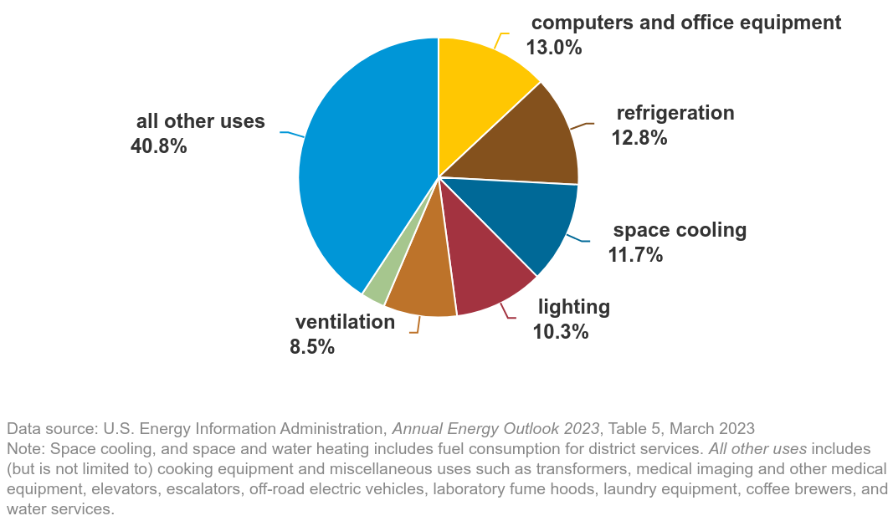
Why Lighting Matters
Lighting = 10–17% of commercial building energy use
One of the fastest ROI upgrades
Impacts:
Safety
Productivity
Comfort

Slide 7
Section 2
Lighting Basics

Slide 8

What is Light?
Light is electromagnetic radiation
Visible spectrum: ~380–780 nm
Humans only see a small portion
Notes:
Speaker Notes:
Keep simple—don’t get too physics-heavy

Slide 9
Human Vision
Eye sensitivity peaks in green range
Poor lighting reduces performance
Good lighting improves accuracy + safety

Slide 10
Lumens
Total light output from a source
Higher lumens = brighter source
Notes:
800 lumens ≈ household bulb

Slide 11
Footcandles
Light level on a surface
1 footcandle = 1 lumen per square foot
Notes:
Office: 30–50 fc
Warehouse: 10–30 fc

Slide 12
Watts vs Lumens
Watts = energy used
Lumens = light produced
Key Idea: 👉 More lumens with fewer watts = better

Slide 13
Efficacy
Efficacy: lumens per watt
Incandescent: ~10–15 lm/W
Fluorescent: ~60–90 lm/W
LED: 120–200 lm/W

Slide 14
Color Temperature
Measured in Kelvin (K)
CCT | Appearance
3000K | Warm
4000K | Neutral
5000K | Cool

Slide 15
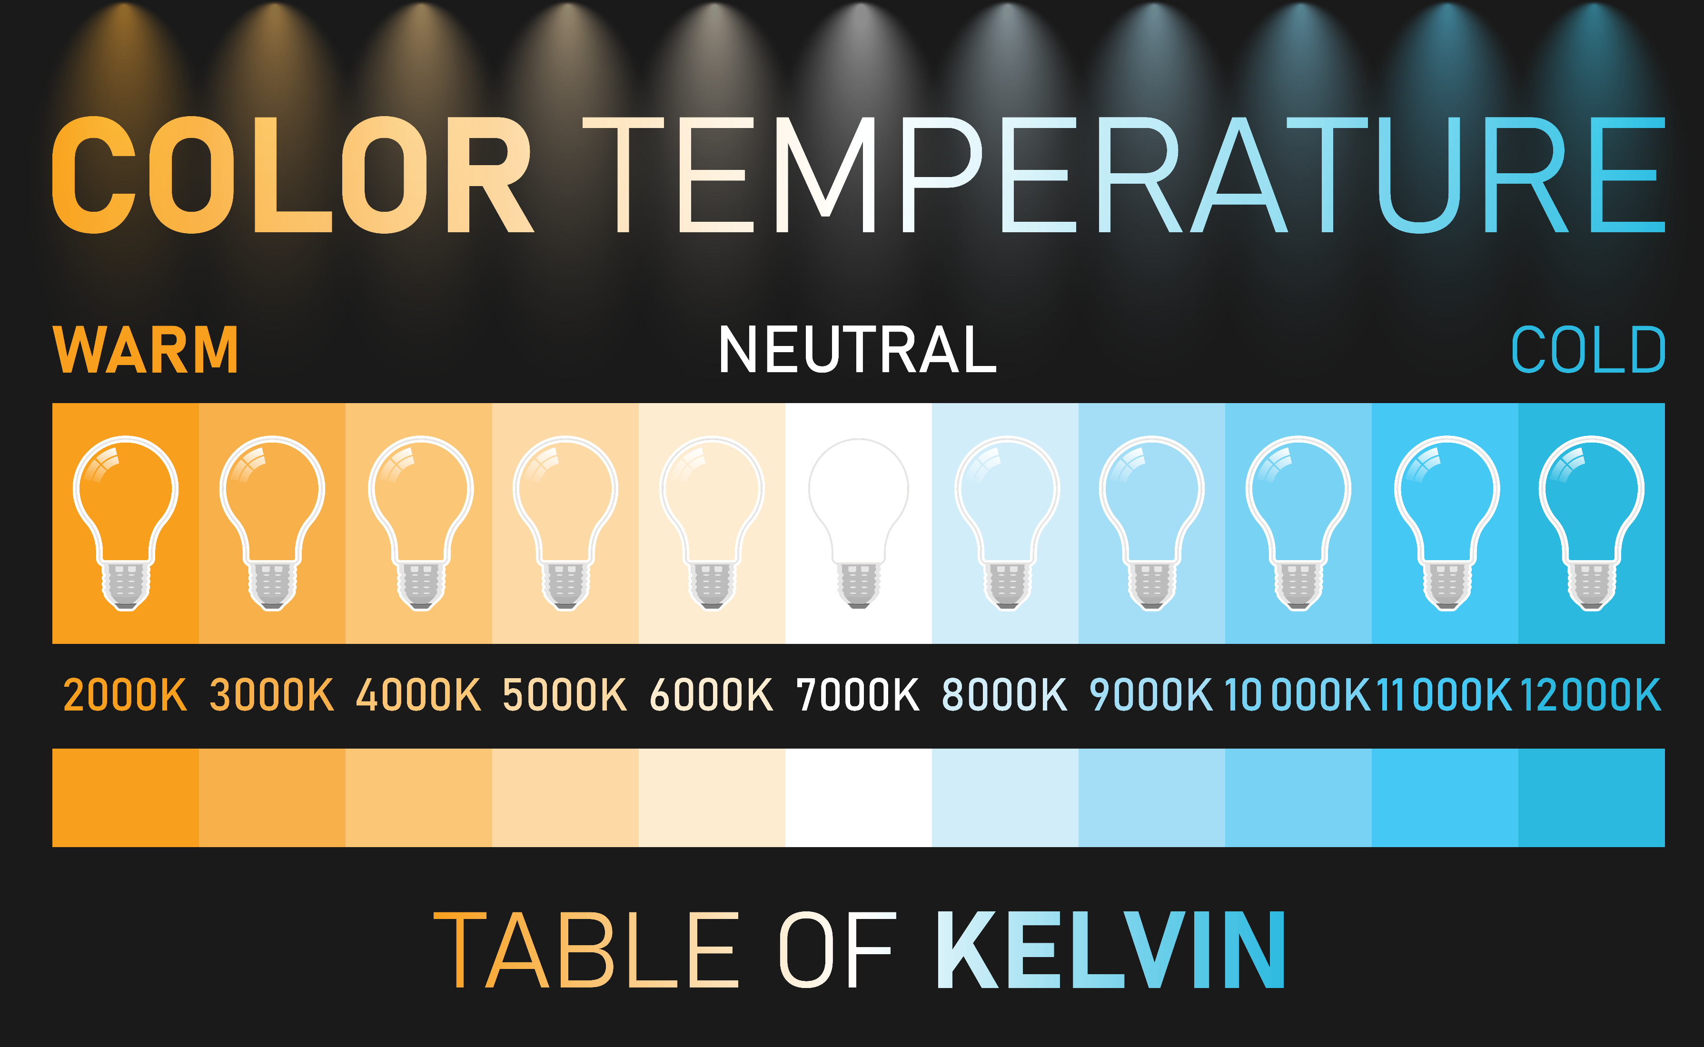
CRI
Color Rendering Index (0–100)
Higher CRI = better color accuracy
Examples:
Retail: high CRI needed
Warehouse: less critical

Slide 16
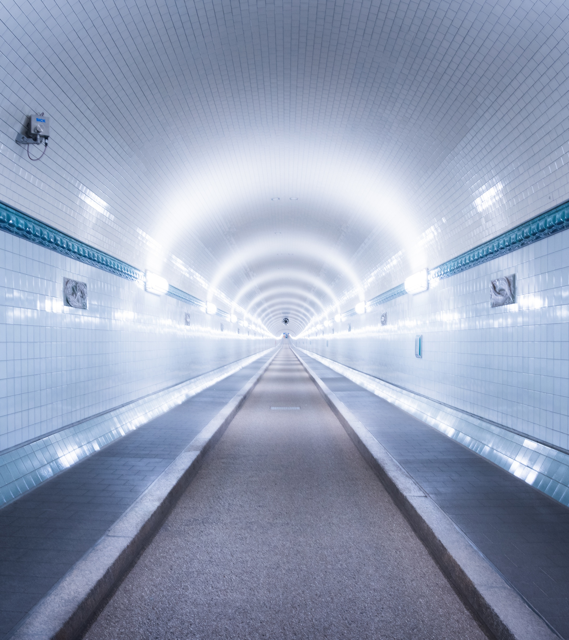
Glare
Excessive brightness causes discomfort
Reduces visibility and safety

Slide 17

Summary of Terms
Lumens = Light output
Footcandles = Light on surface
Watts = Energy consumed
Efficacy = Efficiency
Color temperature = Light color
CRI = Lighting color acuity
Glare = Unwanted lighting reflection

Slide 18

Section 3
Technologies

Slide 19
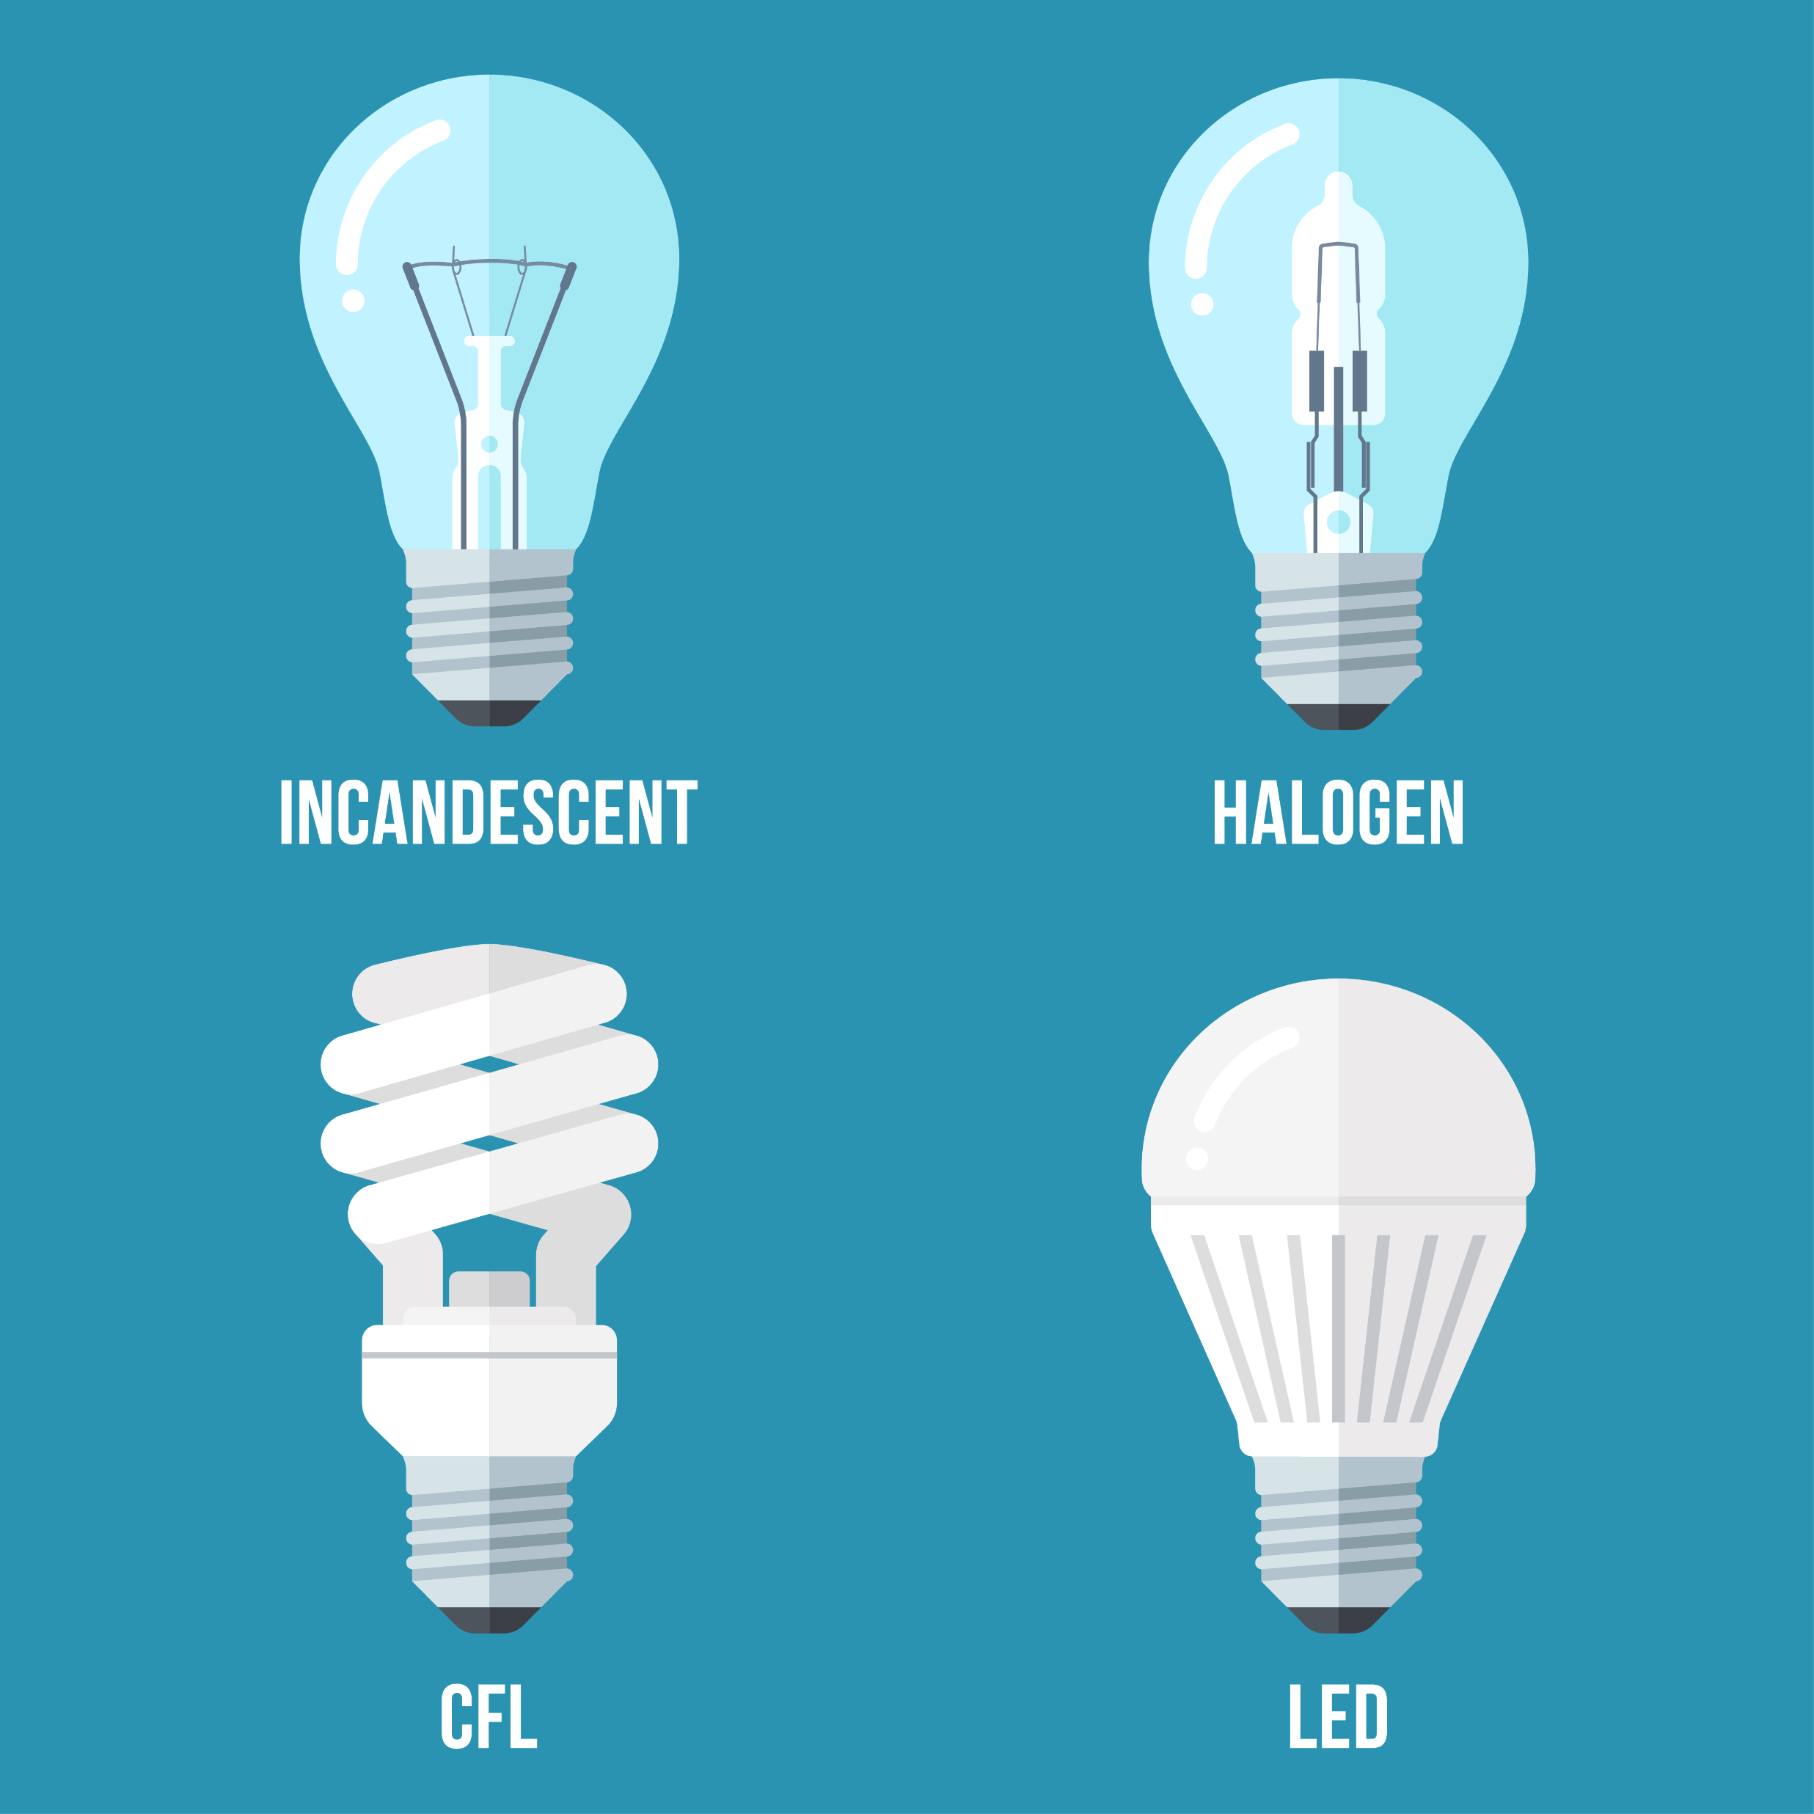
Legacy Lighting
Incandescent
Fluorescent
HID (Metal Halide, HPS)

Slide 20

Incandescent
Very low efficiency
Short lifespan
Mostly obsolete due to federal regulations

Slide 21
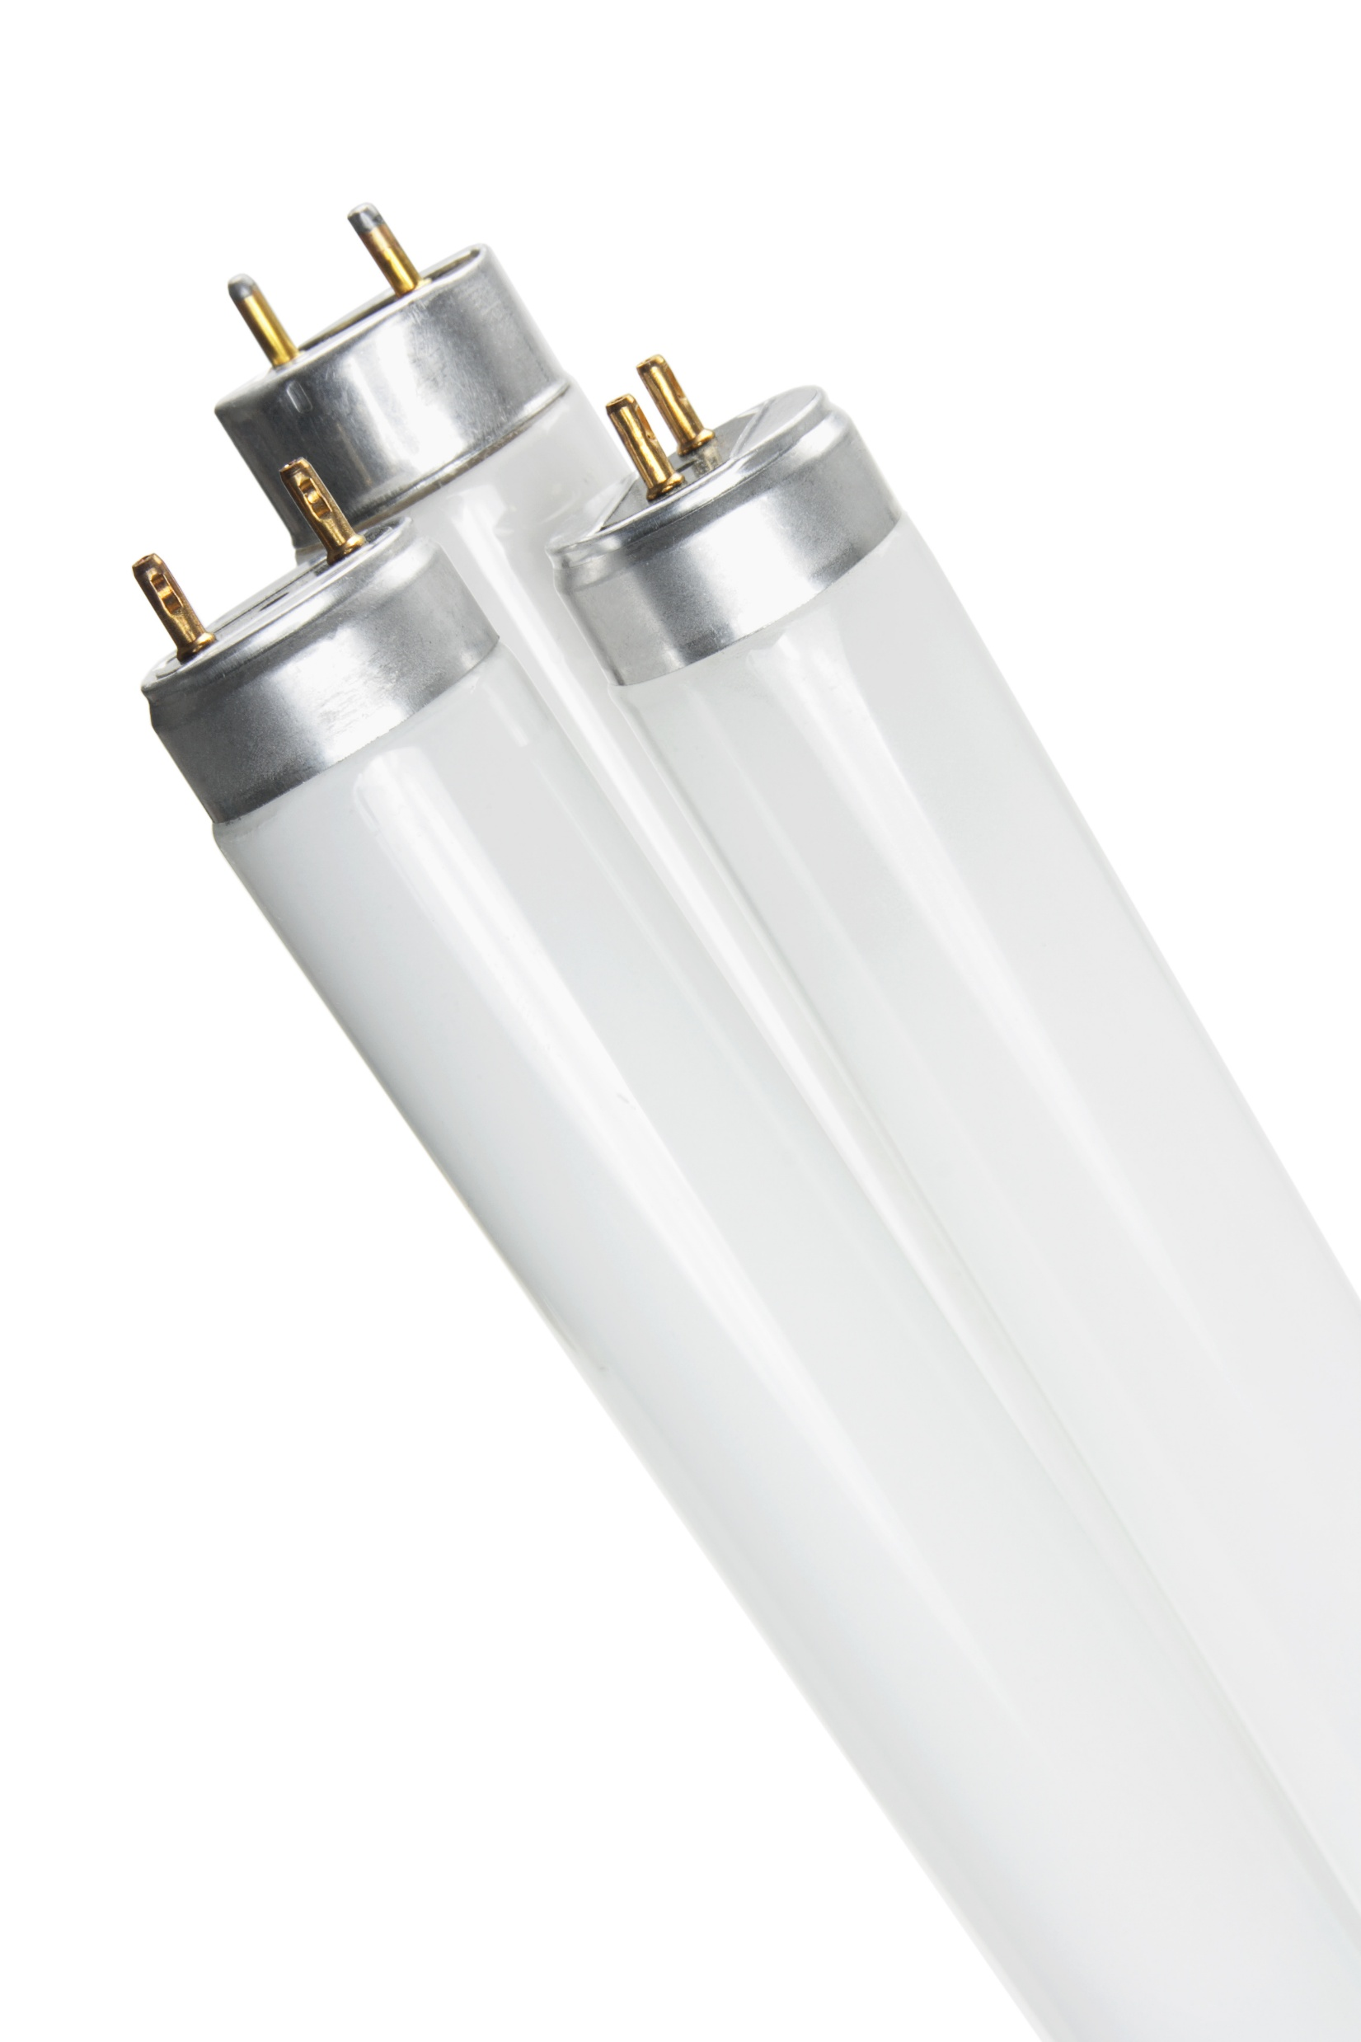
Fluorescents
Requires ballast
Moderate efficiency
Common in offices

Slide 22
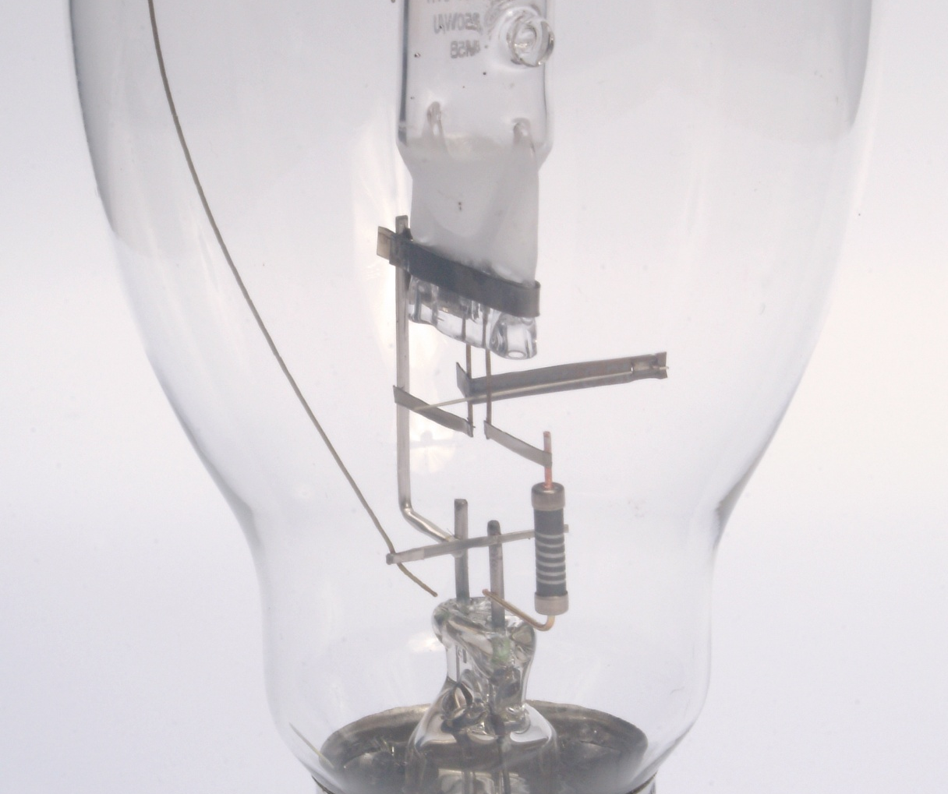
HID Lighting
Metal Halide (white light)
High Pressure Sodium (yellow light)
Mercury Vapor (blue/white light)
Long warm-up time

Slide 23
LED Lighting
Solid-state lighting
High efficiency
Long lifespan
Variety of colors

Slide 24
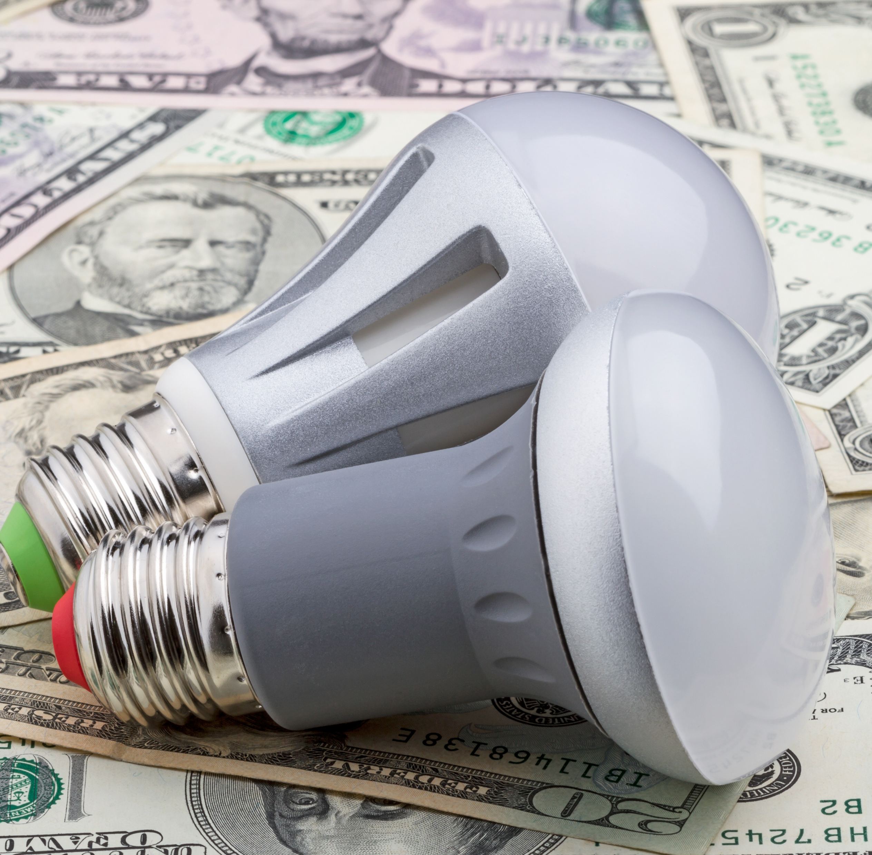
LED Advantages
50–75% energy savings
50,000+ hour life
Instant on
Dimmable

Slide 25
Technology Comparisons
Type | lm/W | Life
Incandescent | 10–15 | 1,000 hrs
Fluorescent | 60–90 | 15,000 hrs
LED | 100–180 | 50,000+ hrs

Slide 26
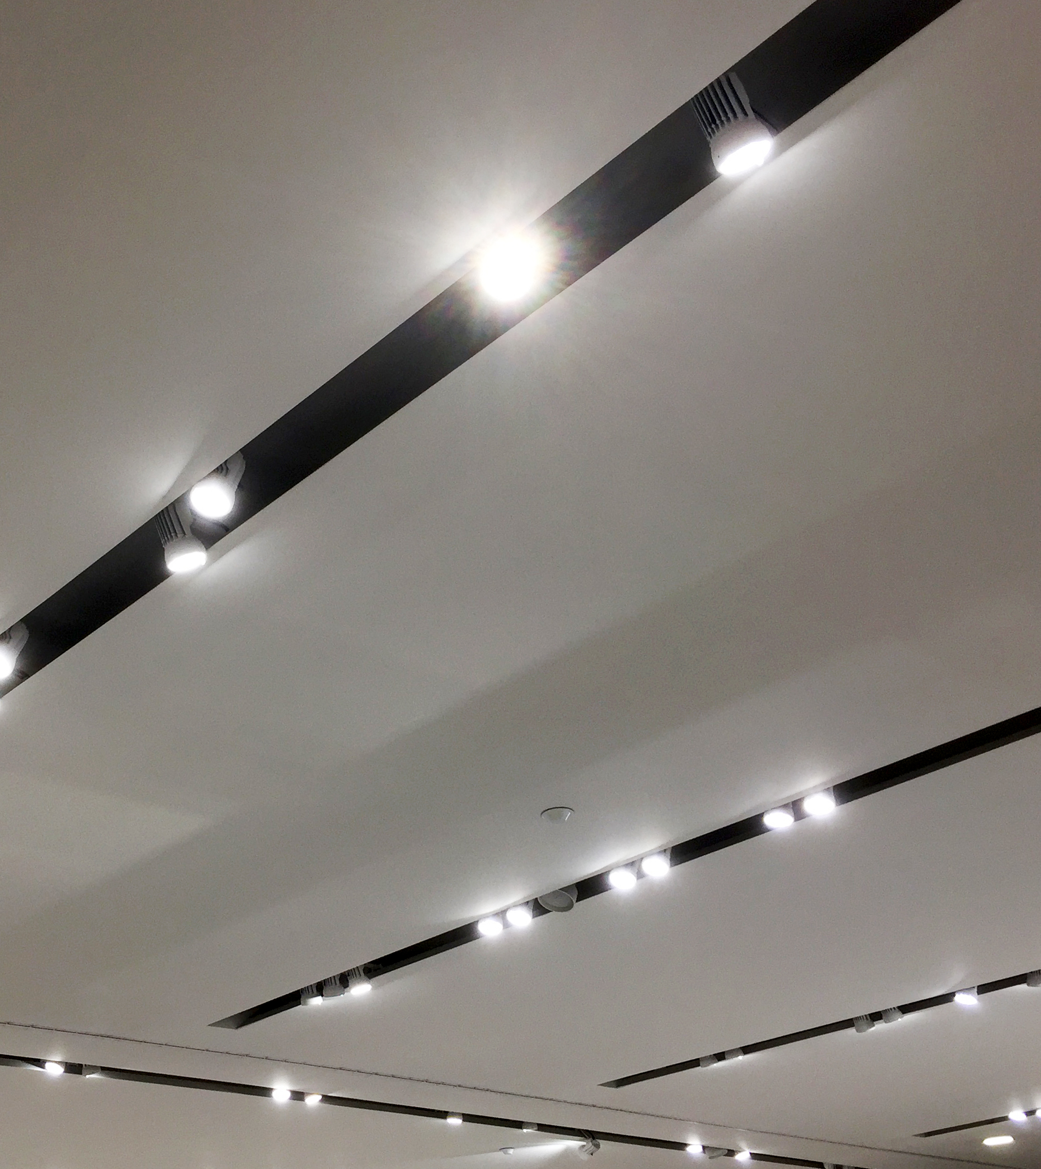
Why LEDs Win
Energy savings
Maintenance savings
Better performance

Slide 27
Where LEDs Struggle
Lamps in enclosed fixtures usually have reduced life
High ambient temperatures

Slide 28

Section 4
Lighting Design- Right light, right place, right amount

Slide 29
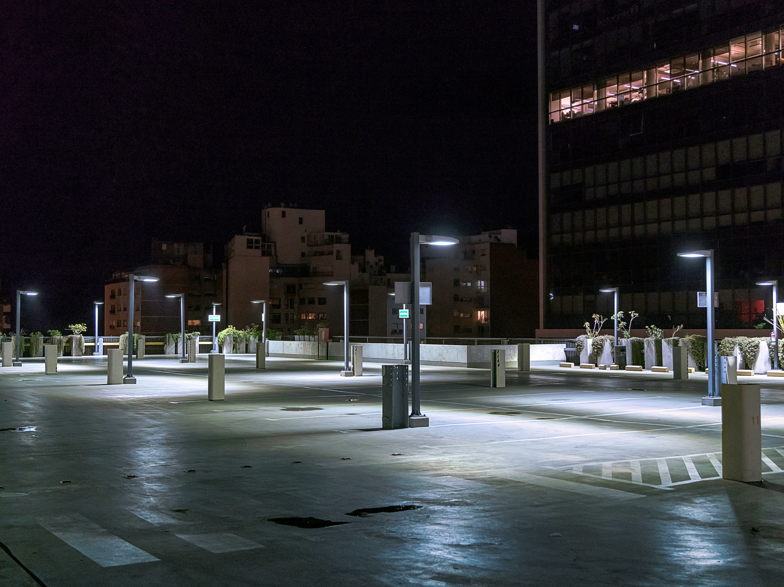
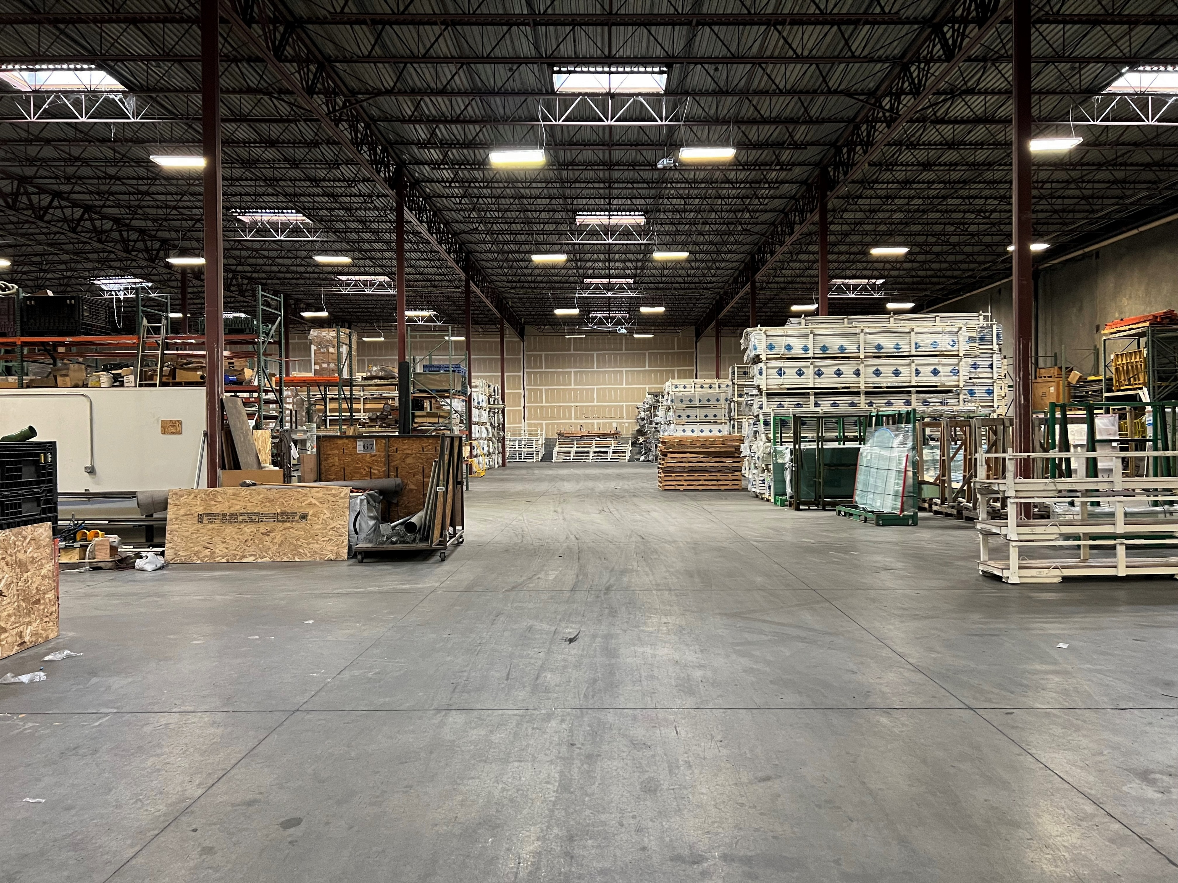
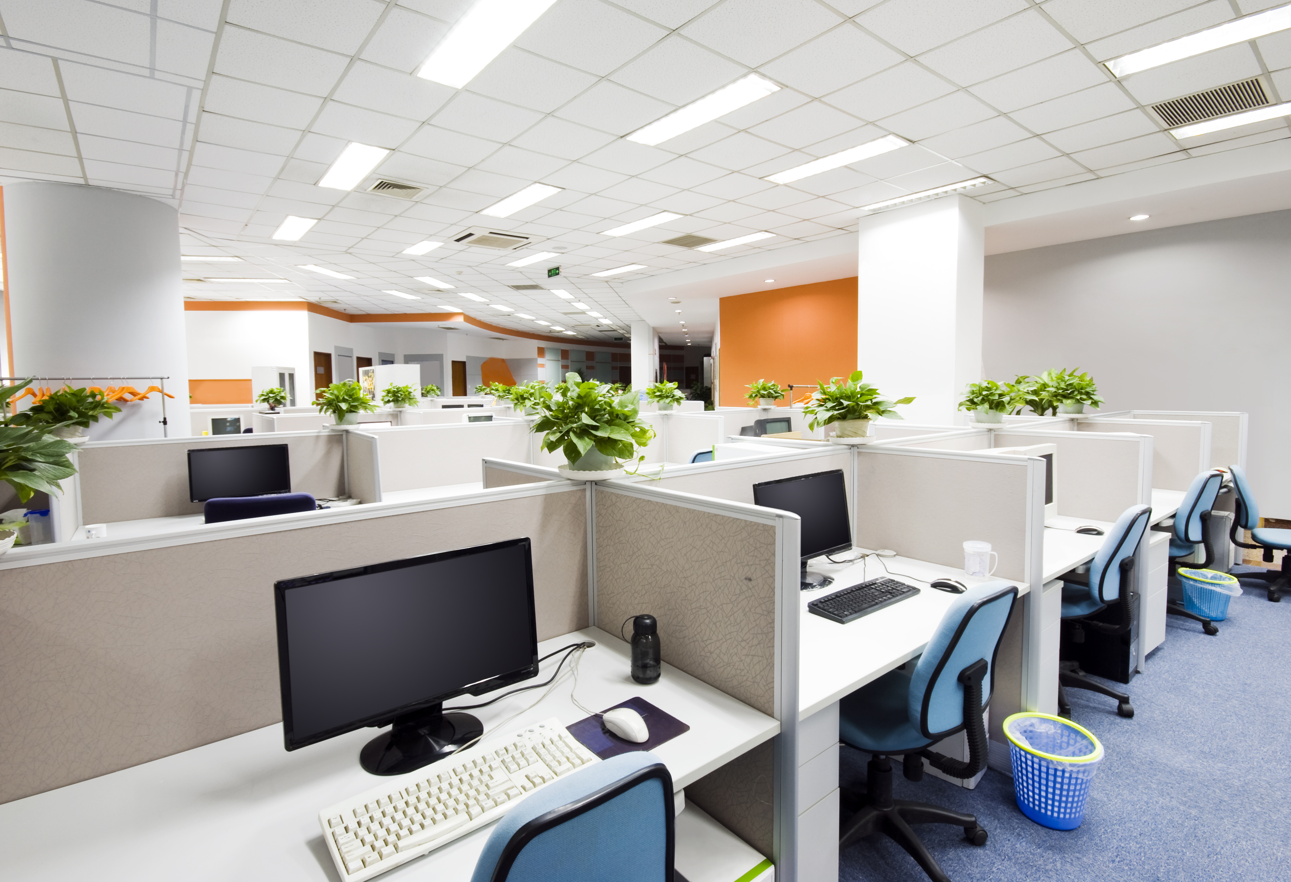
Recommended Light Levels
Parking
1-5 Footcandles
Warehouse
10-30 Footcandles
Office
30-50 Footcandles
Space | Footcandles
Warehouse | 10–30
Office | 30–50
Parking | 1–5

Slide 30
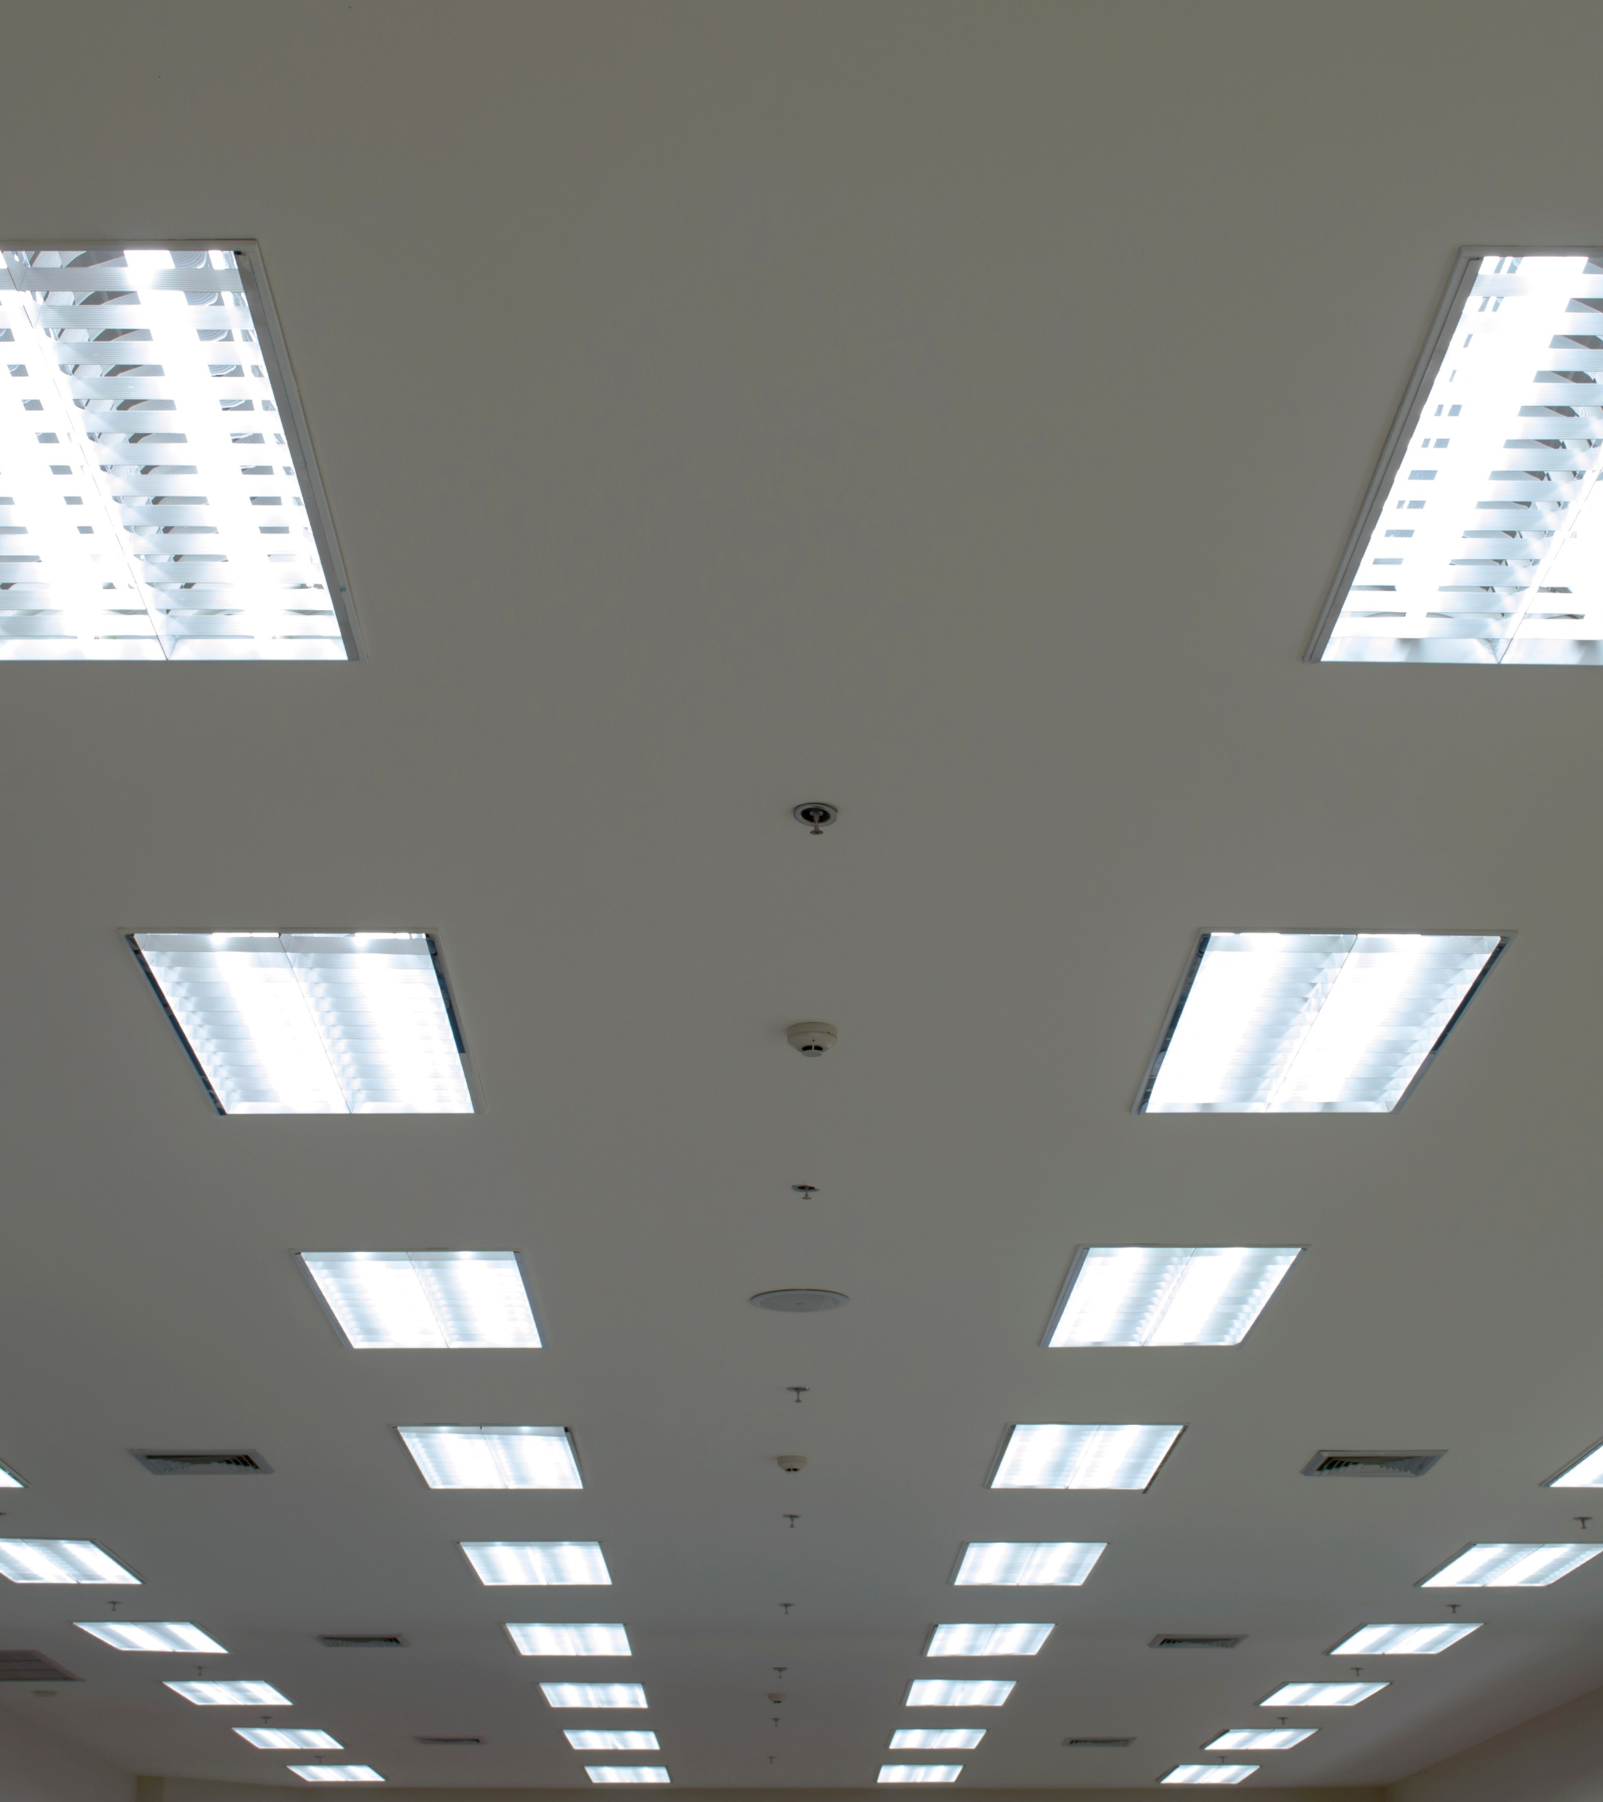
Uniformity
Even lighting distribution
Avoid shadows and hot spots

Slide 31
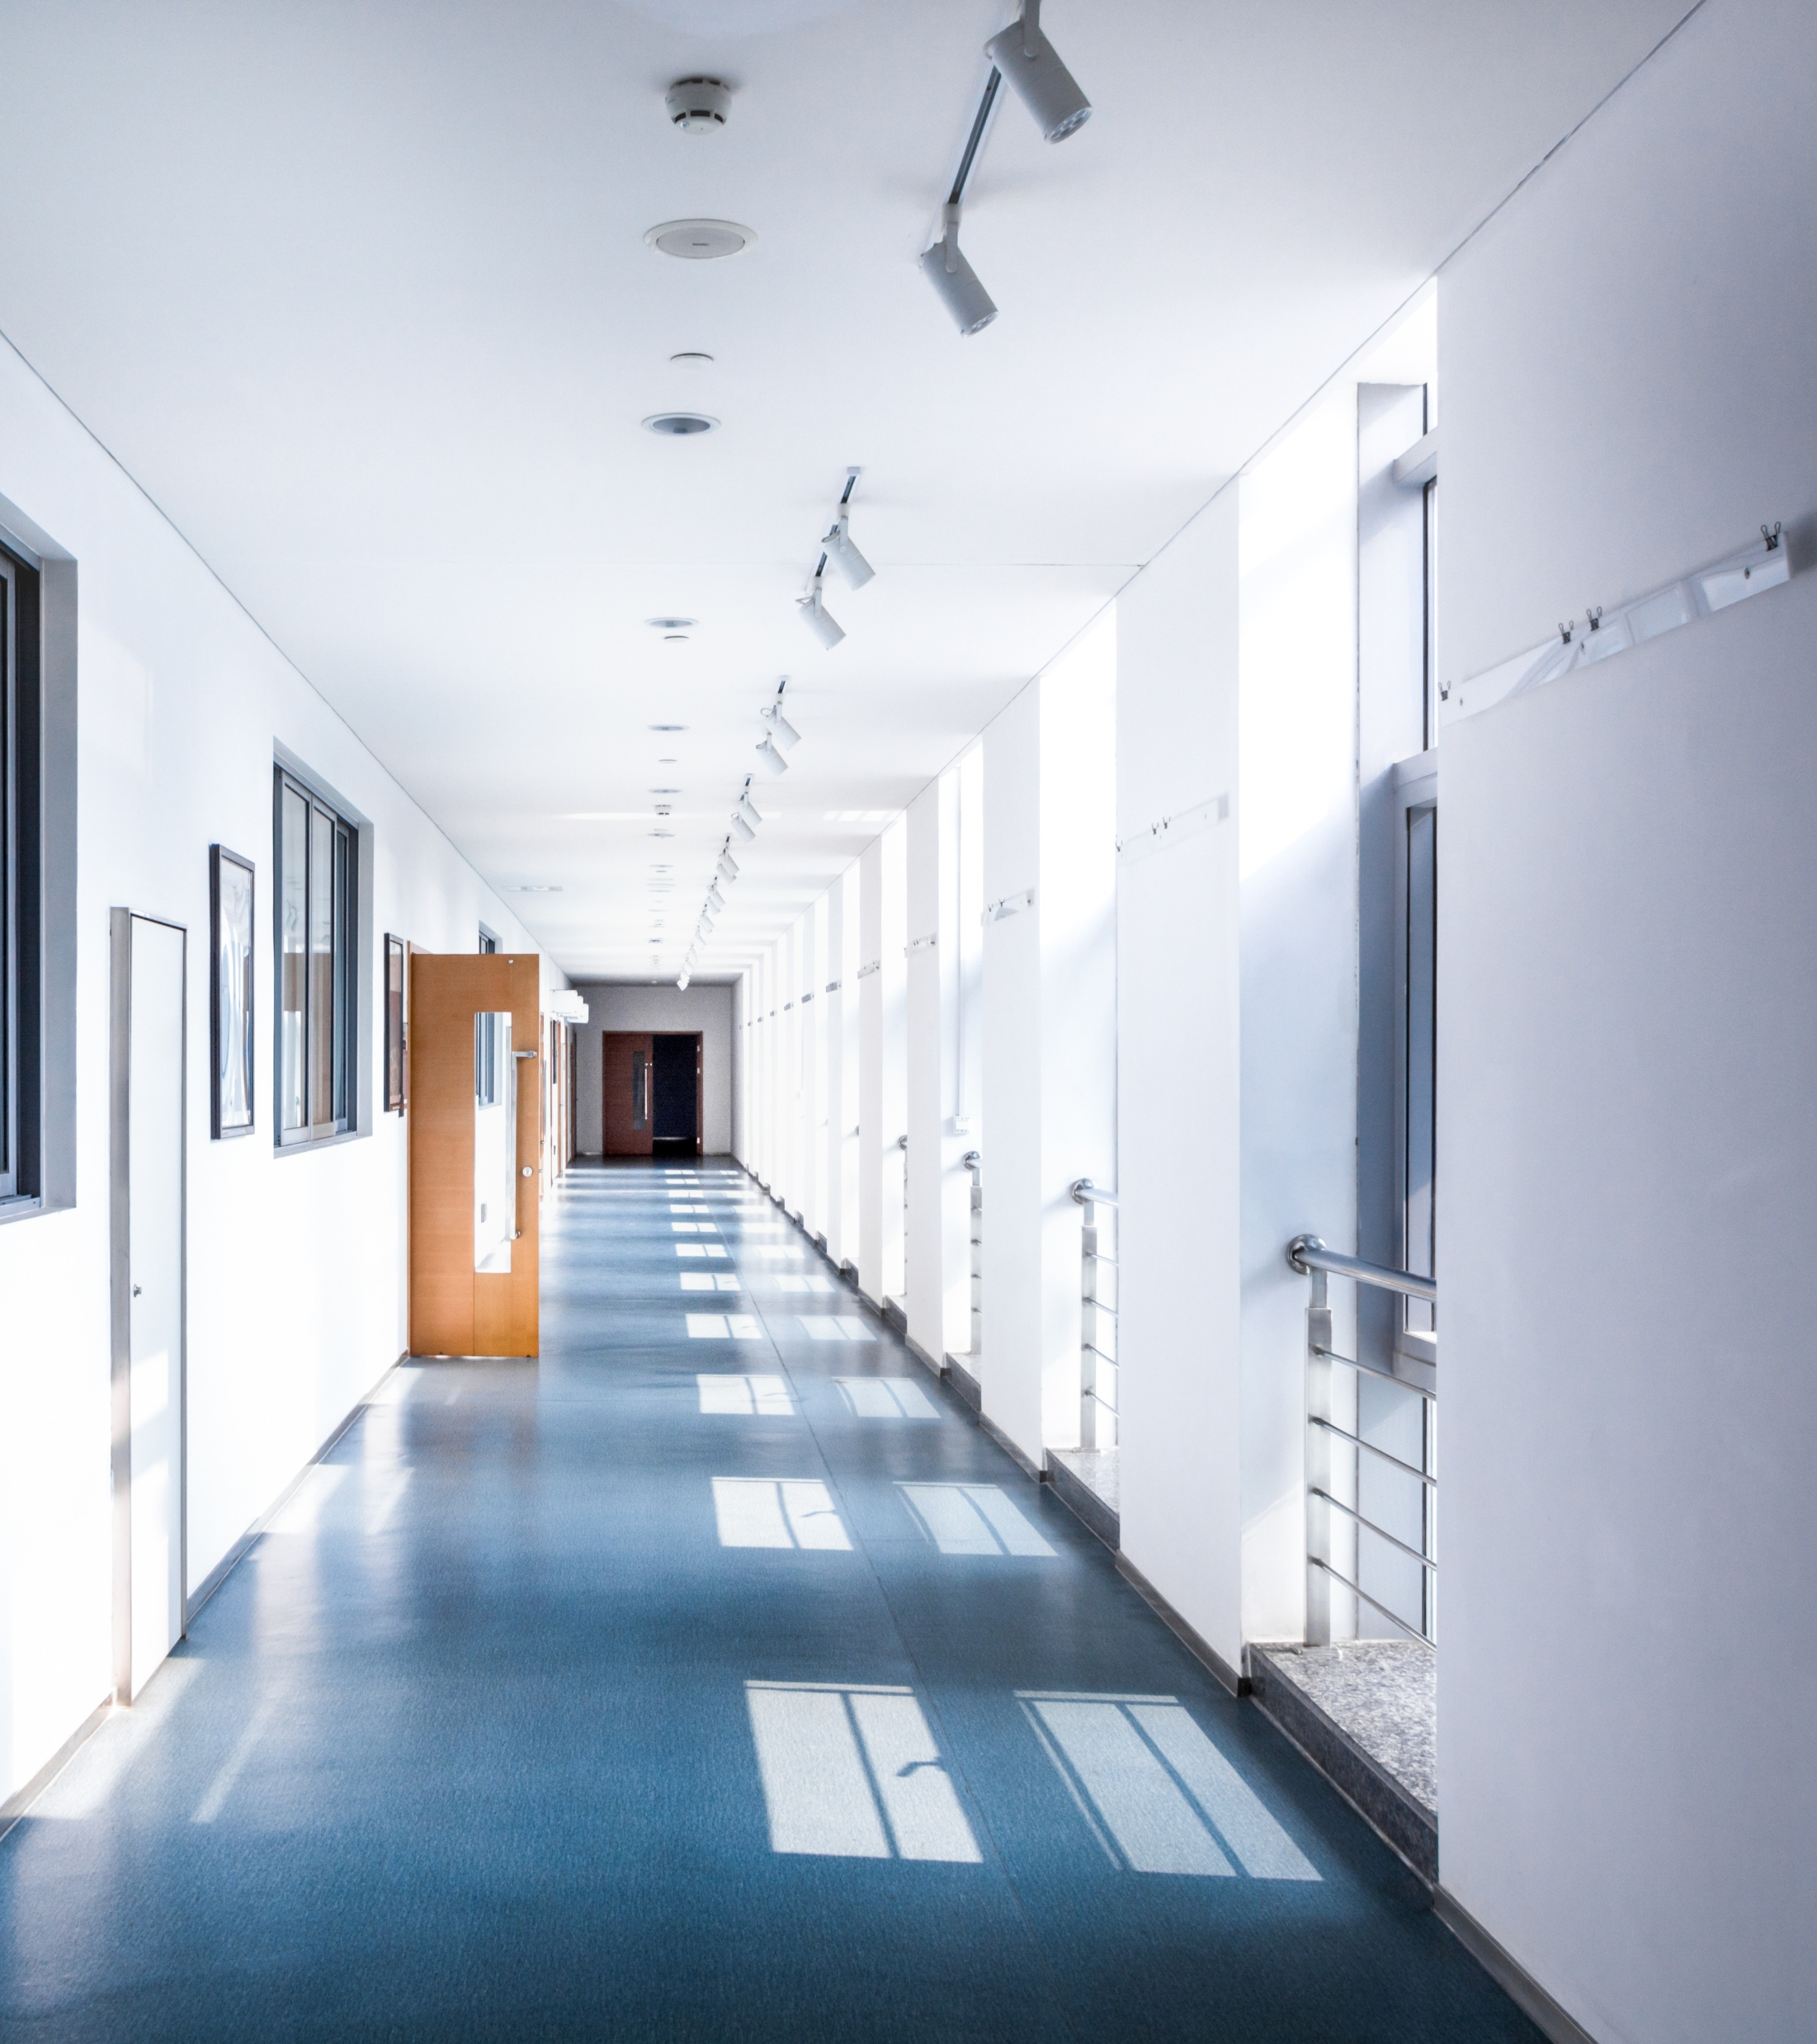
Fixture Spacing
Spacing depends on mounting height and space dimensions
Too wide = dark spots

Slide 32
Mounting Height
Higher = Wider Spread
Lower = More Concentrated

Slide 33
Beam Angles
Narrow = Focused
Wide = Spread Out

Slide 34
Layout Example
Grid Layout
Even Spacing

Slide 35

Common Mistakes
Overlighting
Underlighting
Poor spacing
Wrong color temp

Slide 36
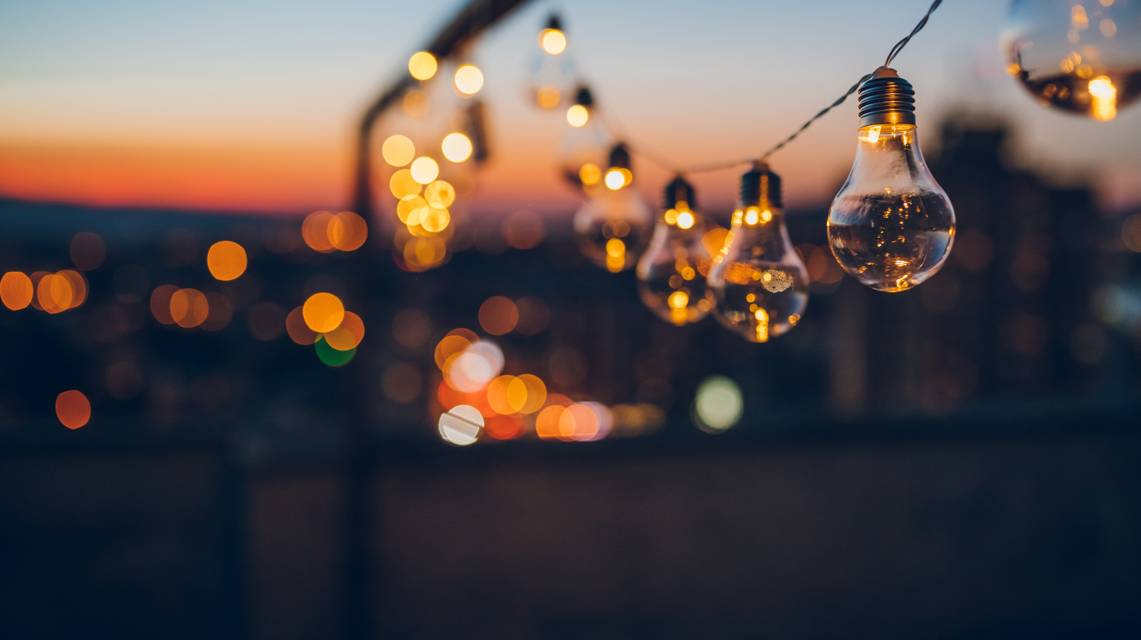
Section 5
Energy Codes

Slide 37
Why Energy Codes Exist
Reduce energy use
Improve efficiency
Standardize buildings

Slide 38
IECC Overview
IECC 2021 Energy Code applies to most projects
Sets max lighting power

Slide 39
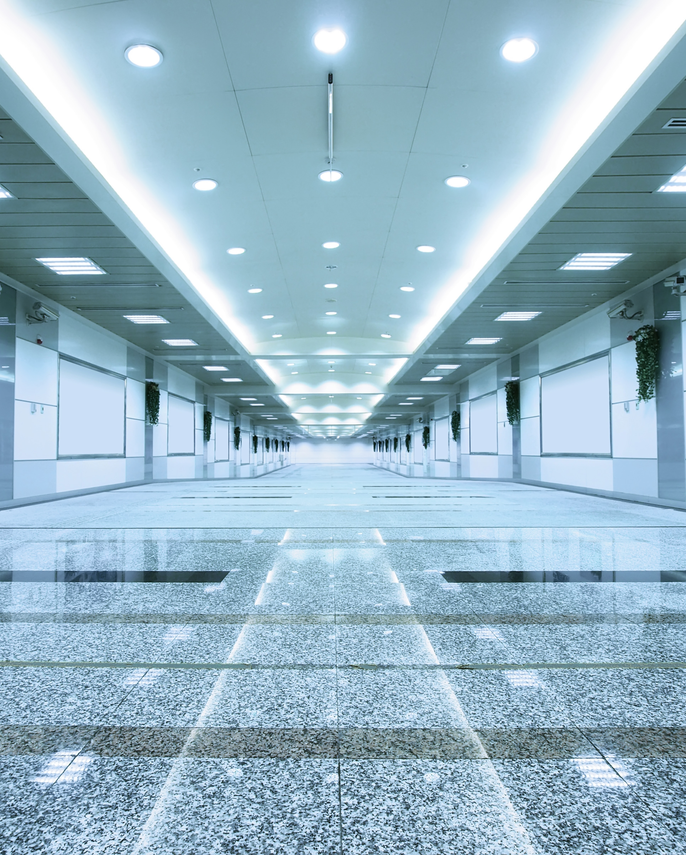
Lighting Power Density
LPD = watts per square foot
Used to limit energy use

Slide 40
Example LPD Values
Space Type | Typical LPD (W/sf)
Office – Open Plan | 0.82
Office – Enclosed | 0.98
Conference Room | 1.23
Classroom | 1.24
Corridor / Hallway | 0.66
Restroom | 0.98
Break Room / Lounge | 0.89
Retail Sales Area | 1.11
Retail Display | 1.60+
Space Type | Typical LPD (W/sf)
Warehouse (bulk storage) | 0.63
Warehouse (fine storage) | 0.93
Parking Garage | 0.18
Parking Lot (exterior) | typically calculated differently
Gymnasium | 1.24
Dining Area / Cafeteria | 0.89
Kitchen / Food Prep | 1.21
Lobby | 1.30
Stairwell | 0.69
Mechanical / Electrical Room | 0.42

Slide 41
Code vs. Reality
Many buildings
exceed code
Retrofits reduce usage

Slide 42
Incentives
Wattsmart utility rebates
Faster ROI

Slide 43
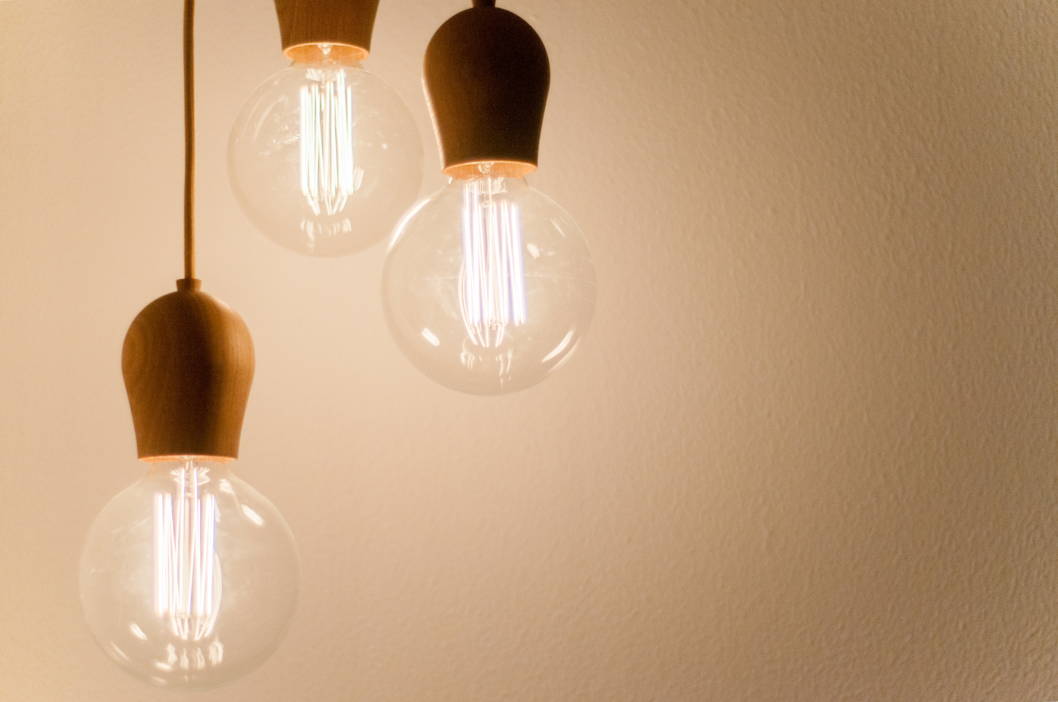
Section 6
Lighting Controls

Slide 44
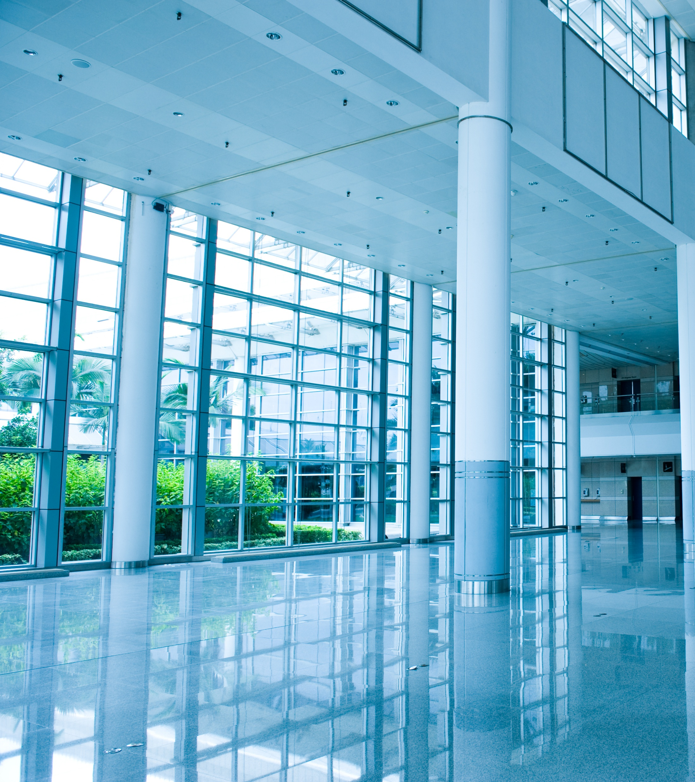
Why Controls Matter
Lights don’t need to be on all the time

Slide 45
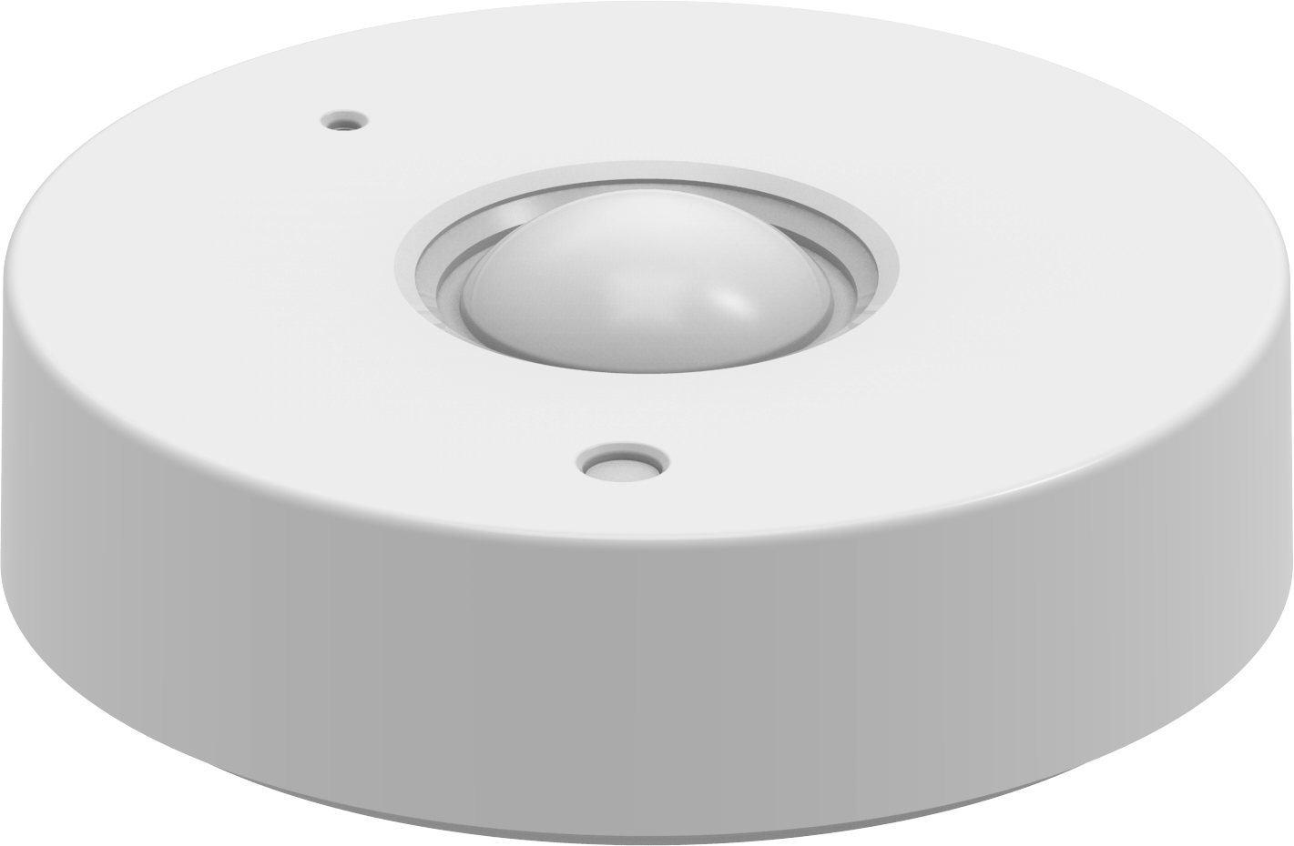
Occupancy Sensors
Turn off when empty
20–40% savings

Slide 46
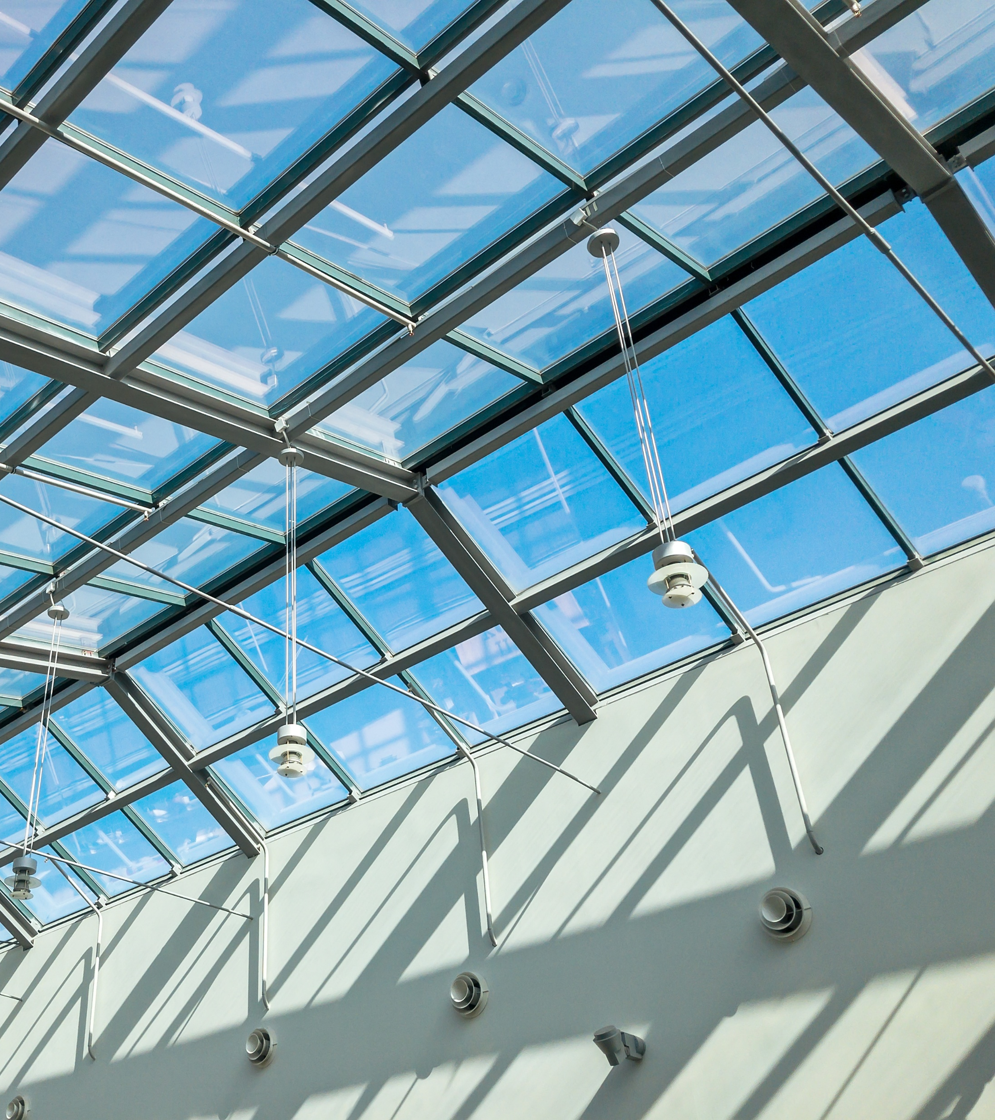
Daylight Harvesting
Adjust based on sunlight

Slide 47

Scheduling
Turn off after hours
Scheduled sweeps
Dim at certain times

Slide 48
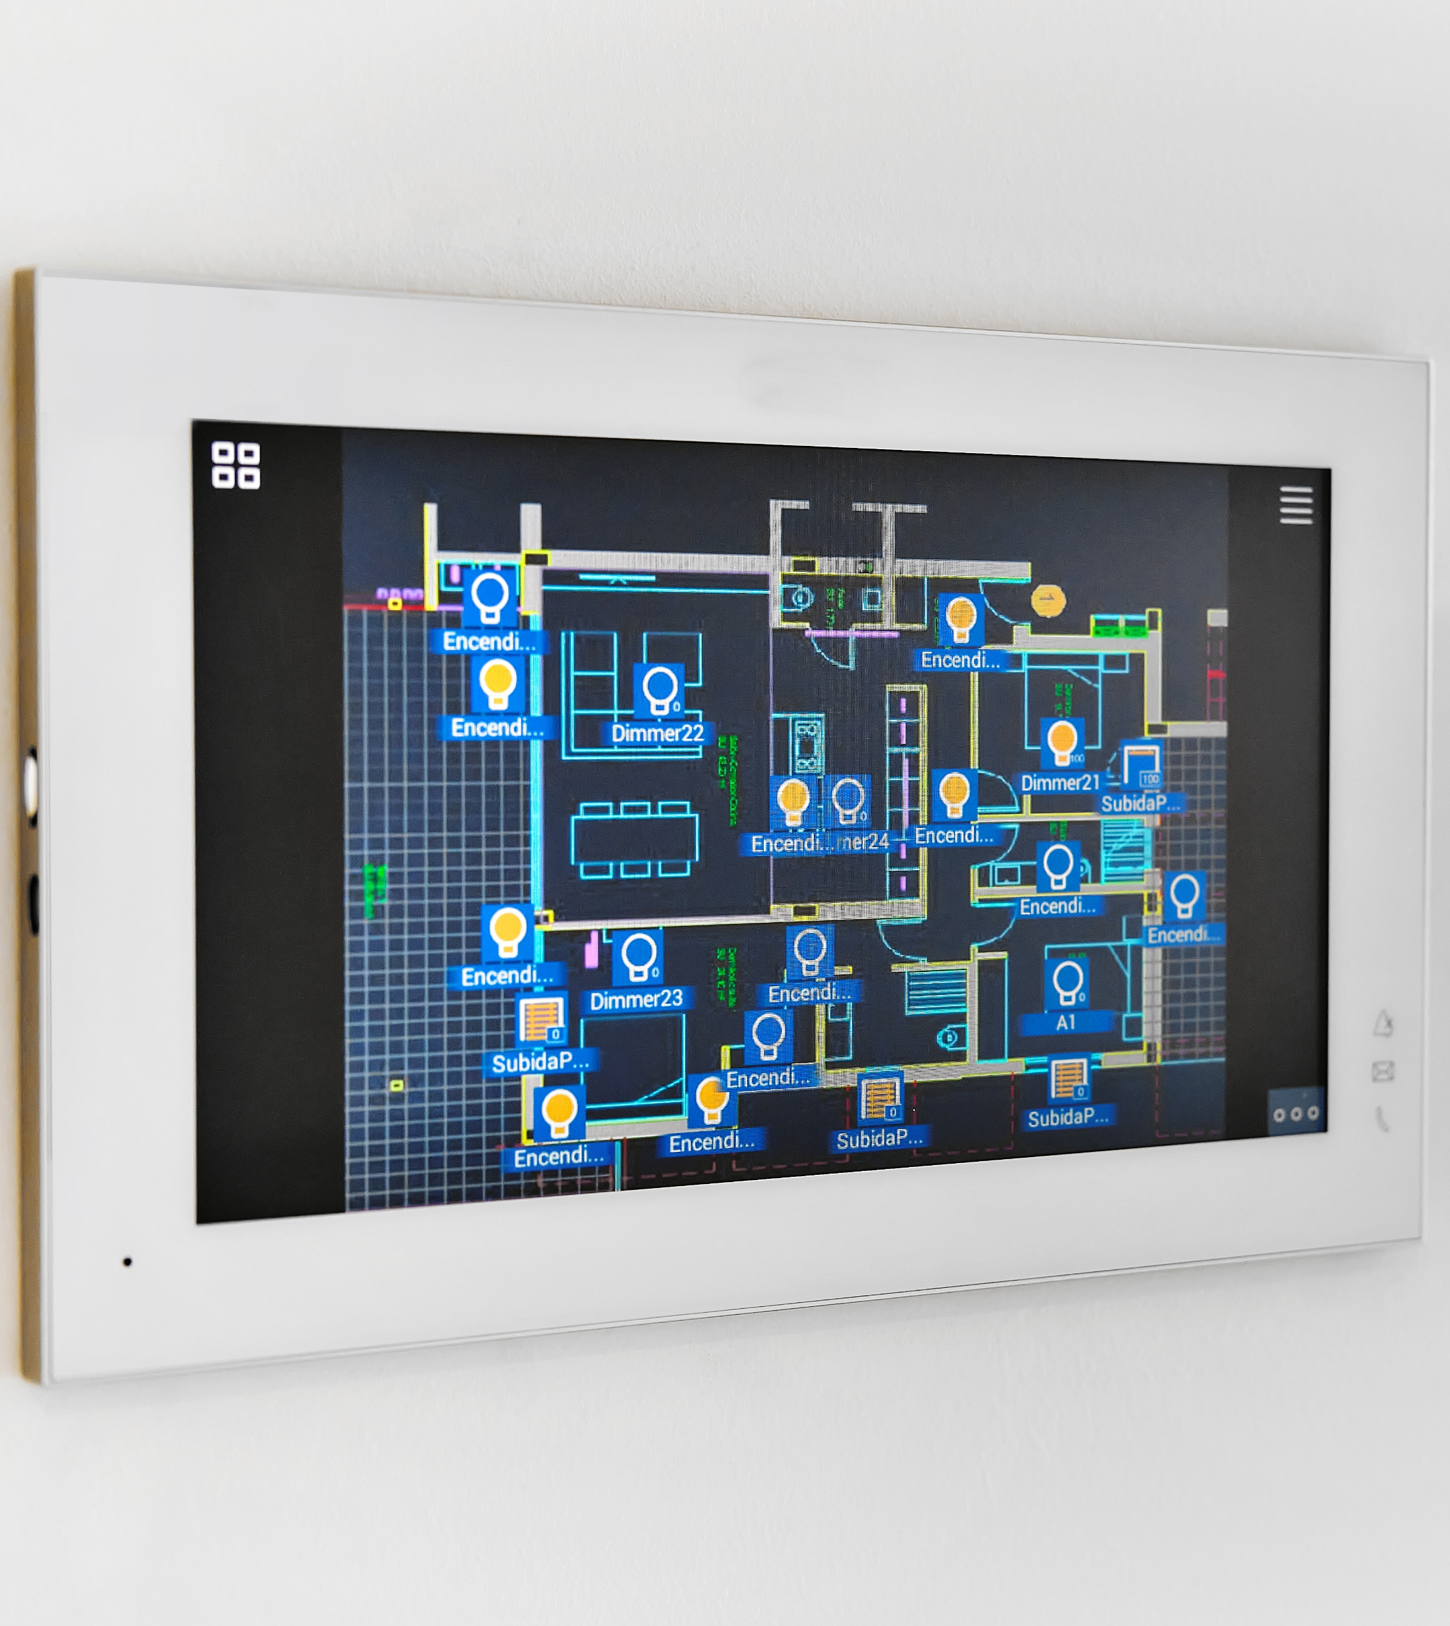
Advanced Controls
Networked systems
Fixture-level control

Slide 49
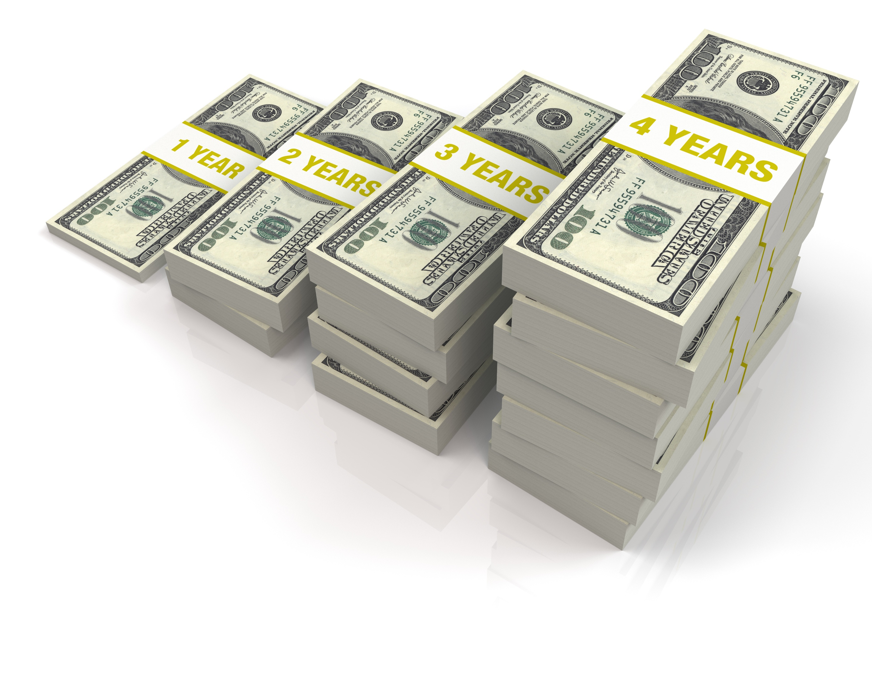
Control Savings
30-70% total savings

Slide 50

Section 7
Wrap-up

Slide 51
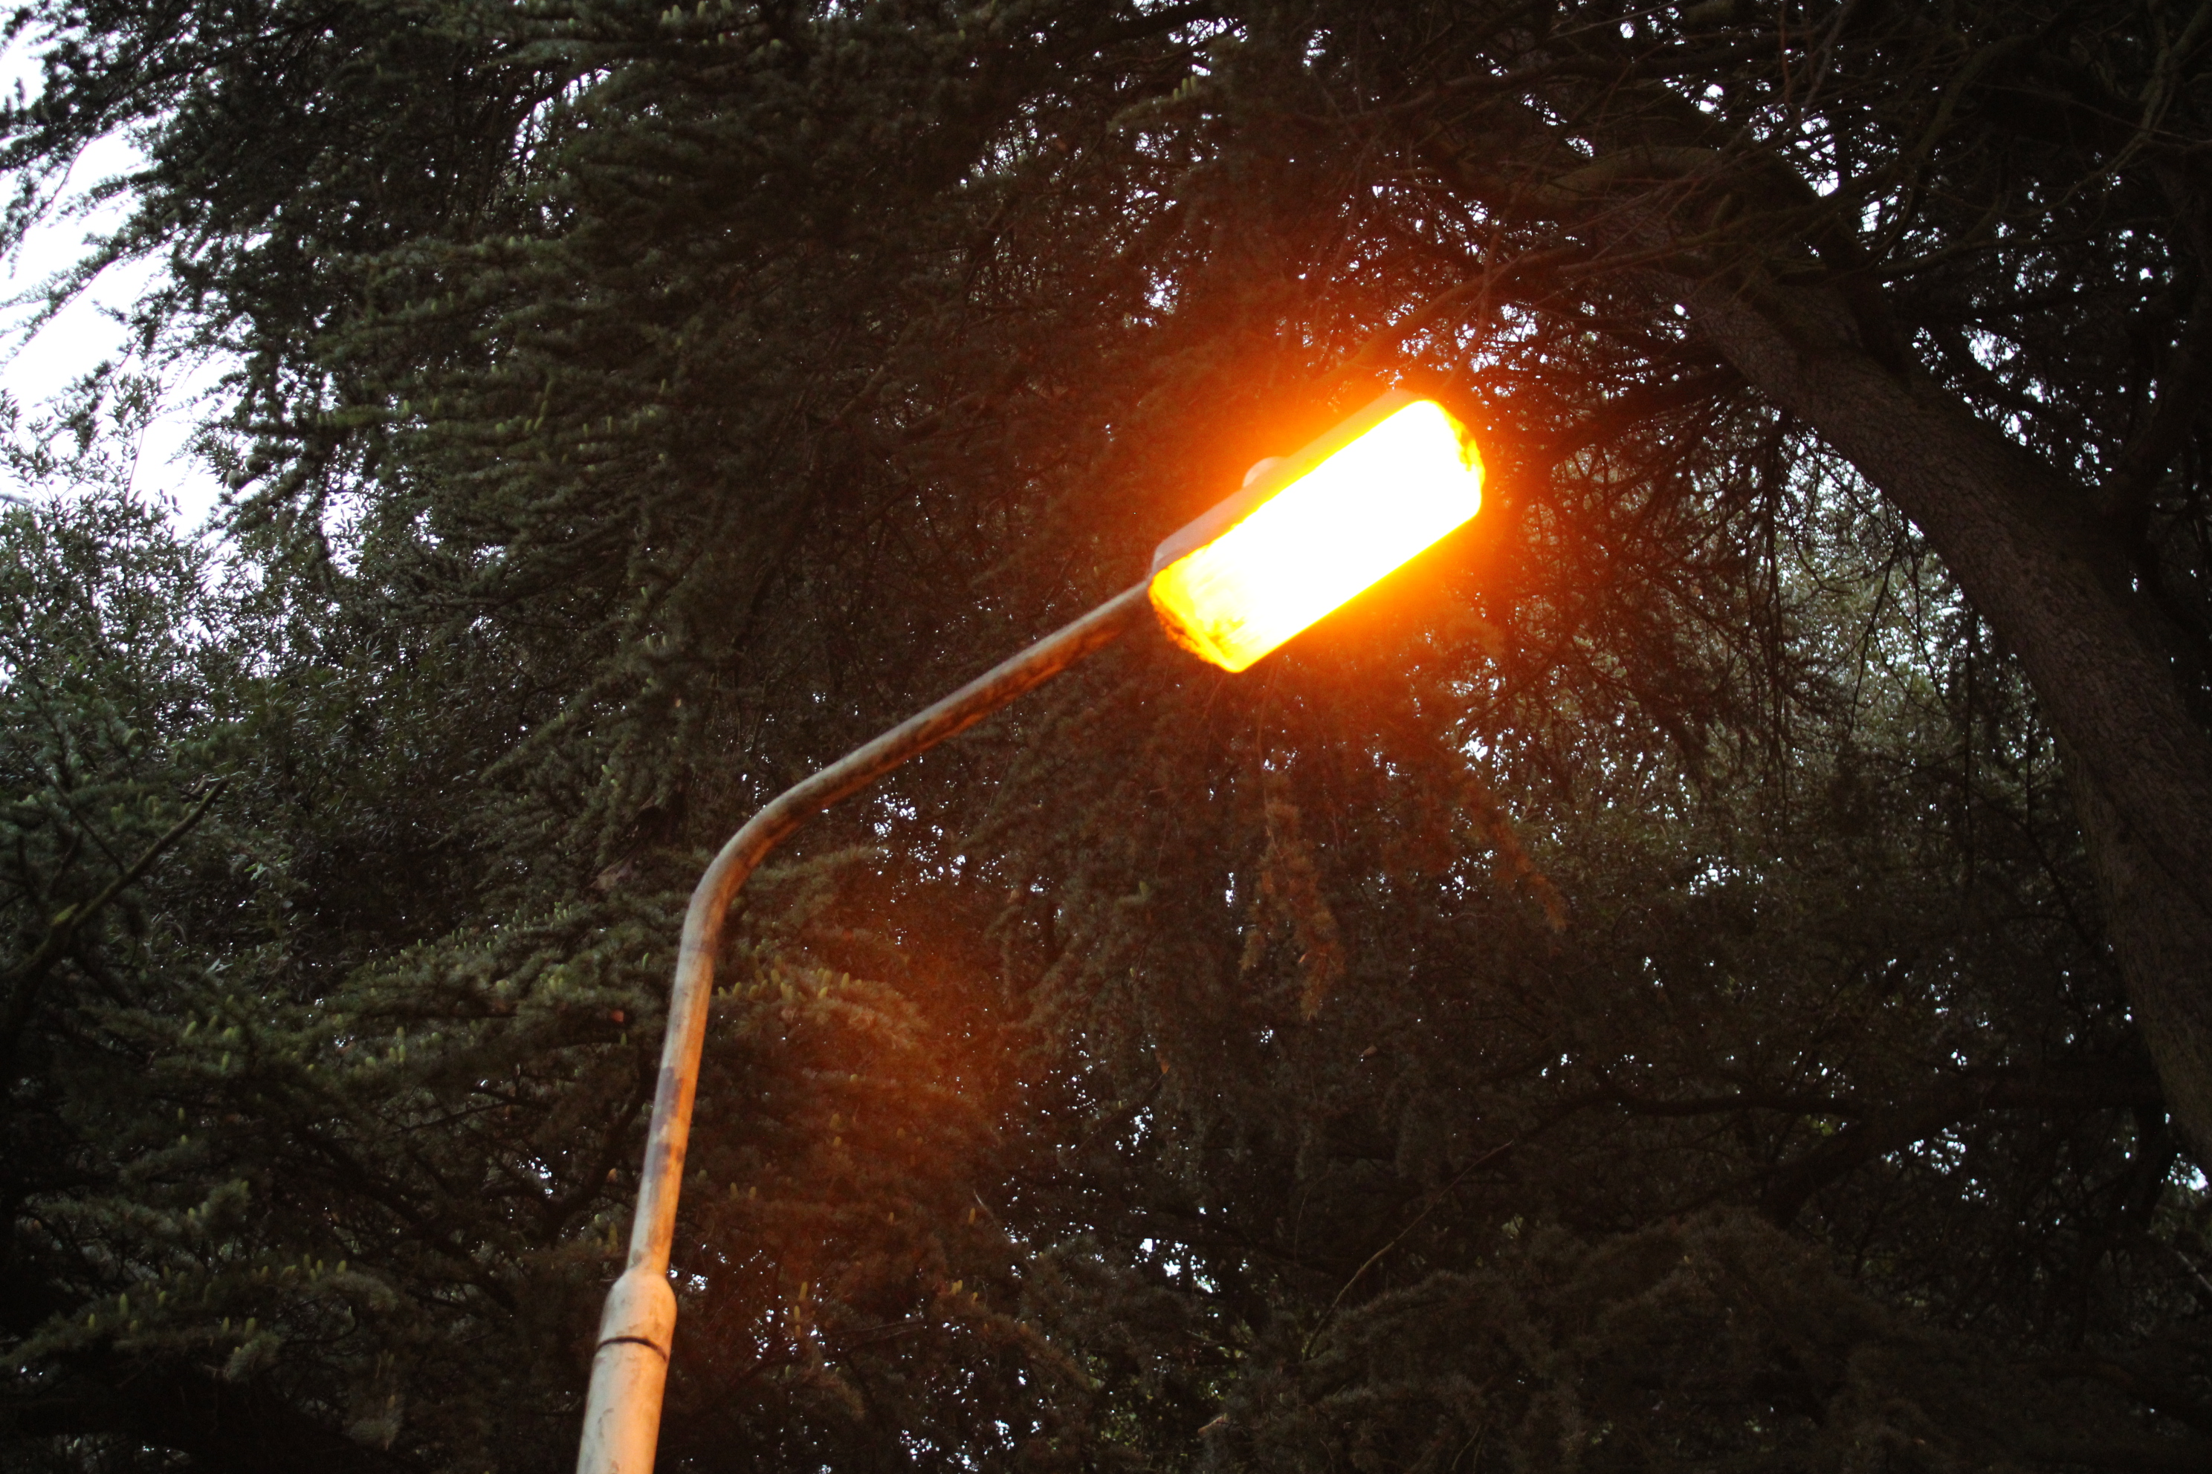
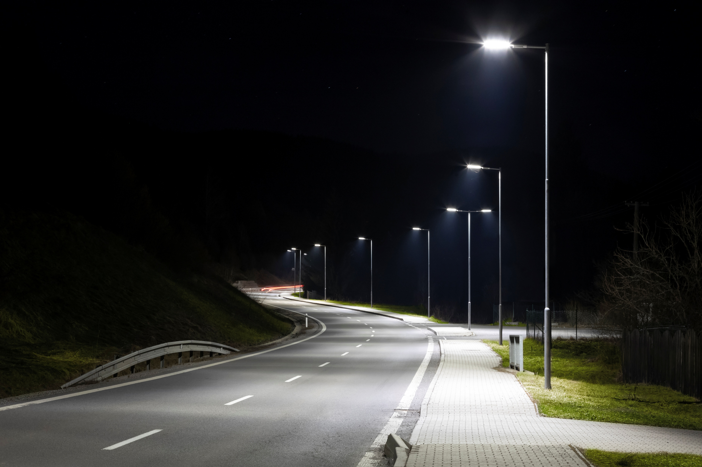
Retrofit Example
400W HID → 150 W LED
60% savings

Slide 52

Key Takeaways
LEDs dominate
Controls are critical
Code matters

Slide 53

Quiz
What are Lumens?
What is LPD?
Name a control strategy
True/False: LEDs are most efficient

