Slide 1
2026 Wattsmart® Expo
WATTSMART BUSINESS

Slide 2
Program Overview
Express: A Path Towards Simplicity
SMBE (Small Medium Business Express)
Typical (Calculated) Path
HVAC and Mechanical
Wattsmart Business Menu

Slide 3





Slide 4
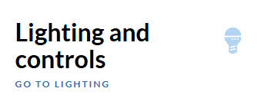
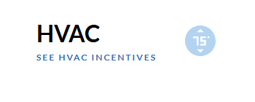
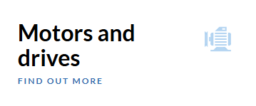
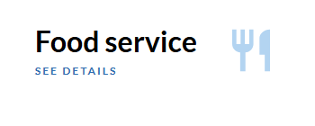
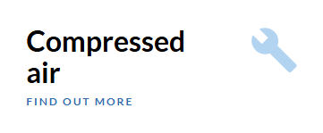
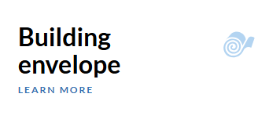
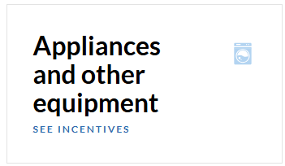

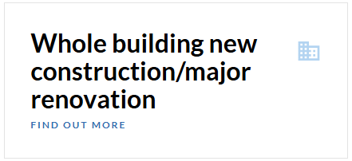
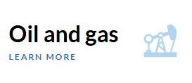
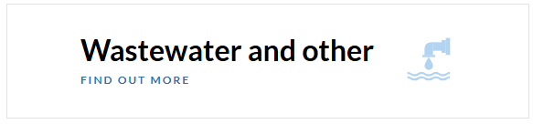

Slide 5





Wattsmart Business Team
Commercial Custom (Managed and Unmanaged) Managed Accounts, Mechanical, ReCx, Custom
Listed Incentives Commercial Lighting, HVAC, Mechanical, Small Business
Midstream Distributor incentives
Industrial/Agricultural (Managed and Unmanaged) Managed Accounts, Mechanical, Custom
Whole Building New Construction/Major Renovation Non-managed, 2 or more systems affected

Slide 6
Wattsmart Business Lighting:
Lighting Express
Small Medium Business Express
Calculated

Slide 7
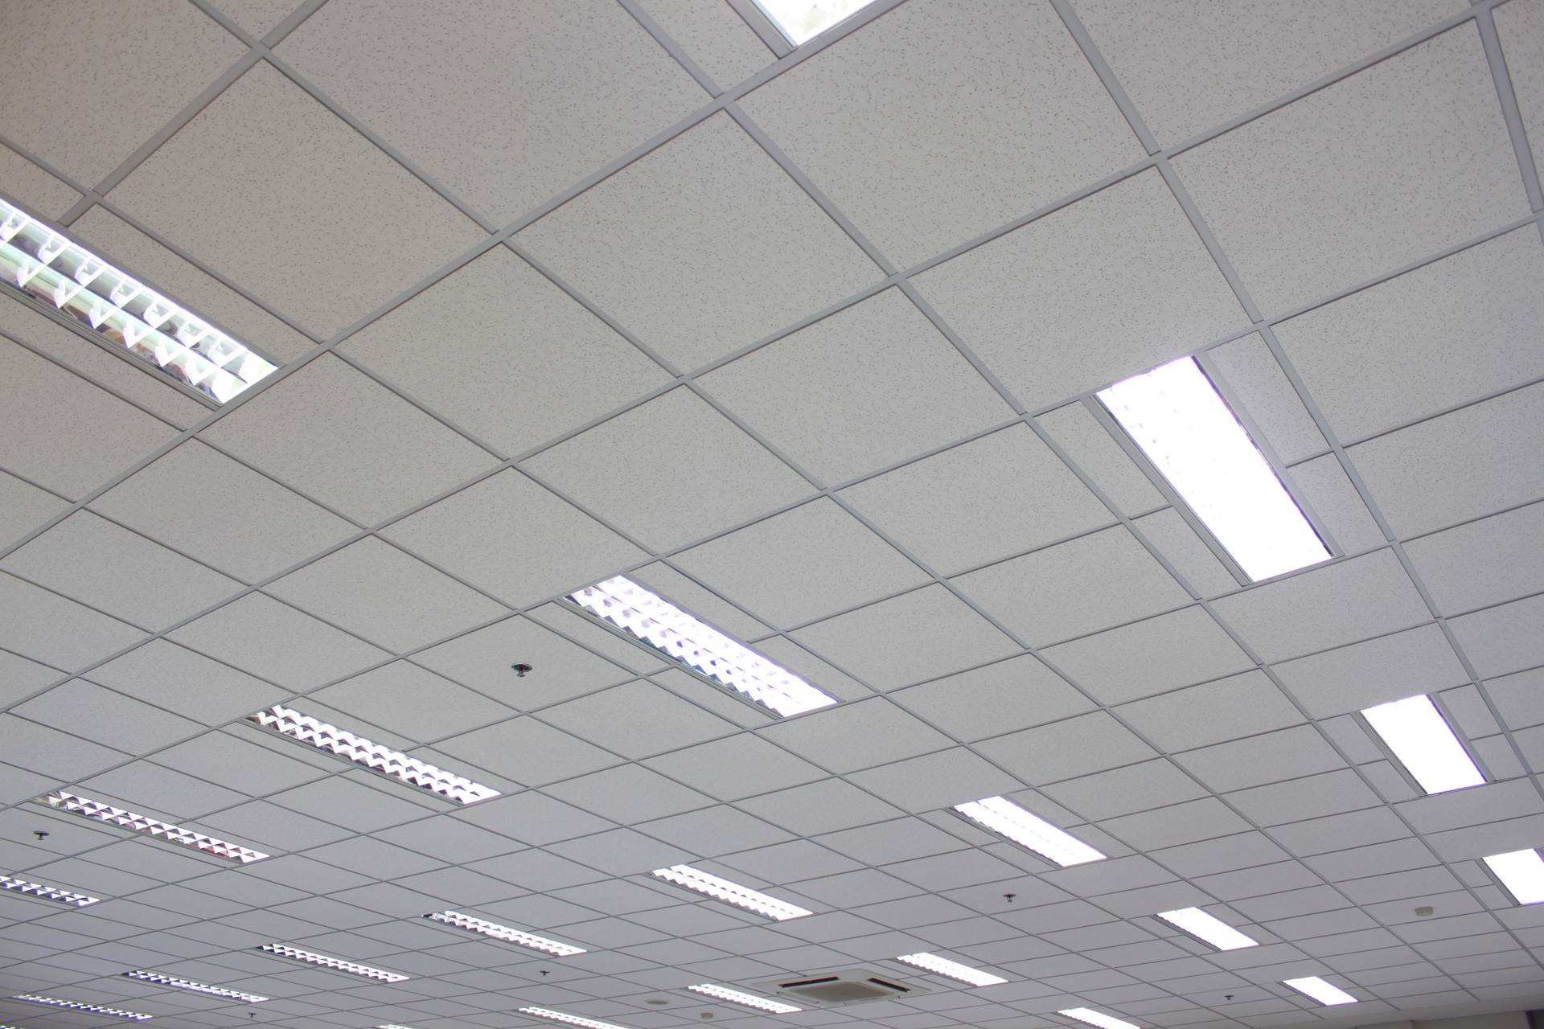
Wattsmart Business Lighting Express
Post-purchase incentive offering where the incentive is based on watts installed.
Replacement must be “like for like” as stated in the Lighting Catalog
Designed for speed and simplicity
Discrepancies may impact incentive eligibility
Follow the rules first, then bid projects accordingly

Slide 8
What is “Like-for-Like”?
A lumen-for-lumen retrofit is an energy-efficiency lighting upgrade where older lighting is replaced with higher-efficacy equipment that reduces watts while maintaining approximately equivalent light output and lighting levels for the same application/space.
Fixture quantity or layout may vary, as long as the project does not constitute a major lighting redesign that significantly alters light levels or space use.
NOT CONSIDERED LUMEN-EQUIVALENT:
Intentionally reducing lighting levels below appropriate standards
Using significantly lower lumen fixtures that compromise visibility or safety
Reducing fixture quantity as a substitute for lumen reduction
Changing lighting design intent (e.g., general lighting → accent lighting)
These scenarios violate like-for-like requirements and may require Custom or Major Renovation review.

Slide 9
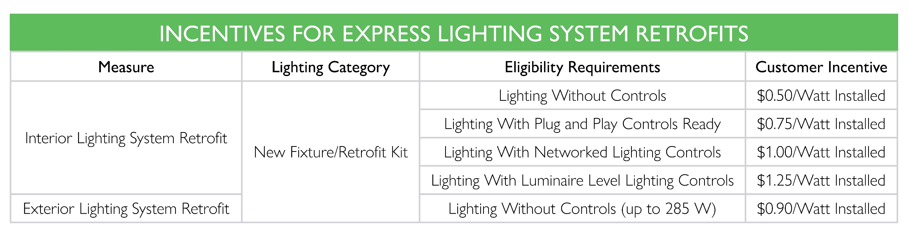
Express Incentive
Express allows you to better provide a bid for projects while on site!
Incentive table drives project value.

Slide 10
How to Submit an Express Project
PERFORM SITE AUDIT
1
Customer Eligibility
Project Eligibility
No LED baseline
No existing controls
BUILD OUT EXPRESS TOOL
2
PRESENT TO CUSTOMER
3
Get signed GA
INSTALL PROJECT
4
SUBMIT REQUIRED DOCUMENTATION FOR INCENTIVE
5
Equipment must be DLC Certified
With proposed equipment
Collect tax form W9

Slide 11
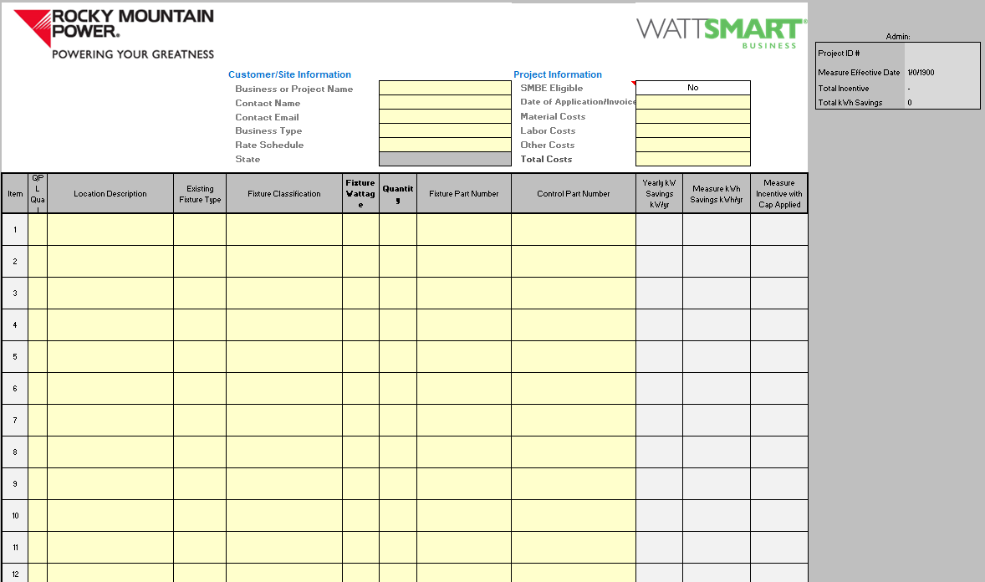
1
3
2
4
1
Enter project name and customer info
2
Select Business Type and enter rate schedule and state
3
Enter invoice date and project costs
4
Enter existing and proposed equipment information
5
Submit copy of tool with required docs

Slide 12


Express Project Checklist
General Application
Express Lighting tool or Express supplement page
IRS Form W-9
Invoice with labor and materials itemized
Spec sheets/QPLs with model number highlighted; wattage highlighted if using a selectable wattage fixture
Controls spec sheet (with part number highlighted) if LLLC, NLC, or Plug & Play Ready

Slide 13
Best Practices
Products must meet Wattsmart program requirements (DLC listed)
Verify eligibility before installation
Accurate documentation ensures smooth processing
Use Express tool to submit projects
Follow project checklist carefully
Ensure all required documentation is included

Slide 14

Small Medium Business Express (SMBE)
Same process as Express
Designed for verified small and medium business customers
Simplified participation for eligible customers
Covers up to 75% of eligible project costs (labor and material)

Slide 15
SMBE Checklist & Eligibility
Review SMBE project checklist
Live eligibility demo during training
PROJECT CHECKLIST
General Application
Lighting tool
Invoice with labor and materials itemized
Spec sheets/QPLs with model number highlighted; wattage highlighted if using a selectable wattage fixture
Controls spec sheet (with part number highlighted) if LLLC, NLC, or Plug & Play Ready

Slide 16

Calculated Path
Best for projects with higher complexity
Major Renovation
LED baseline projects
Exterior lighting exceeding 285W
Controls-only projects

Slide 17
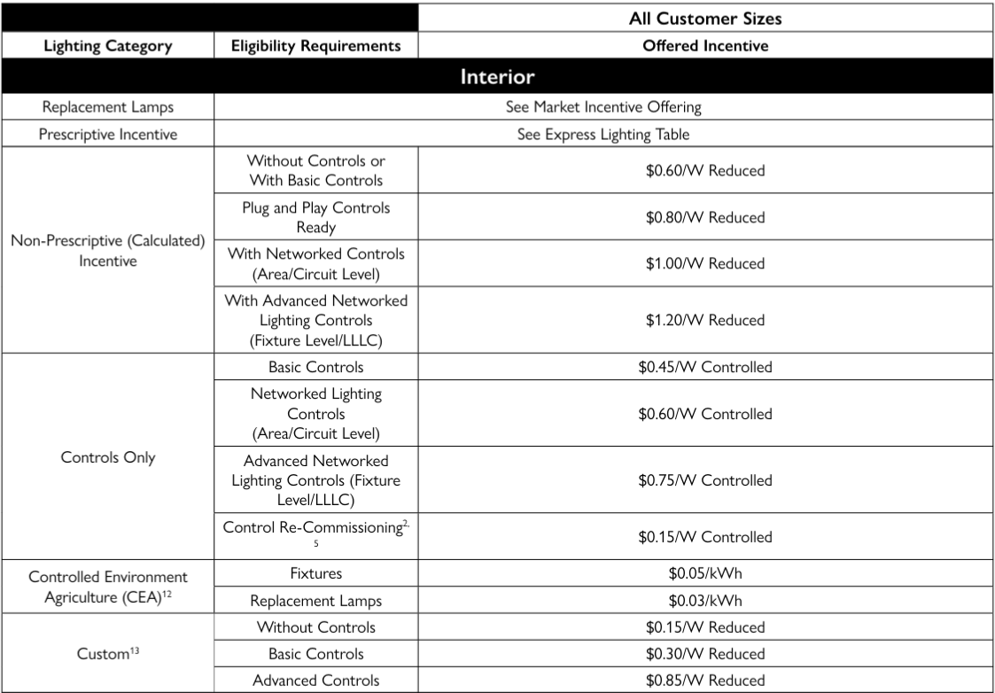
Lighting Retrofit Incentive Table Interior

Slide 18
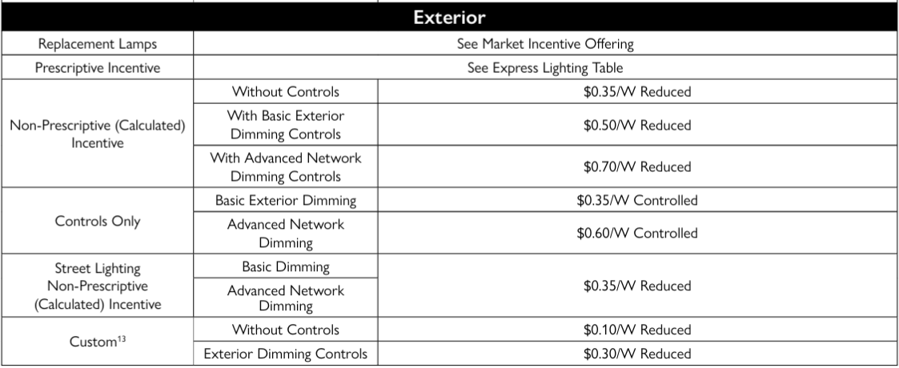
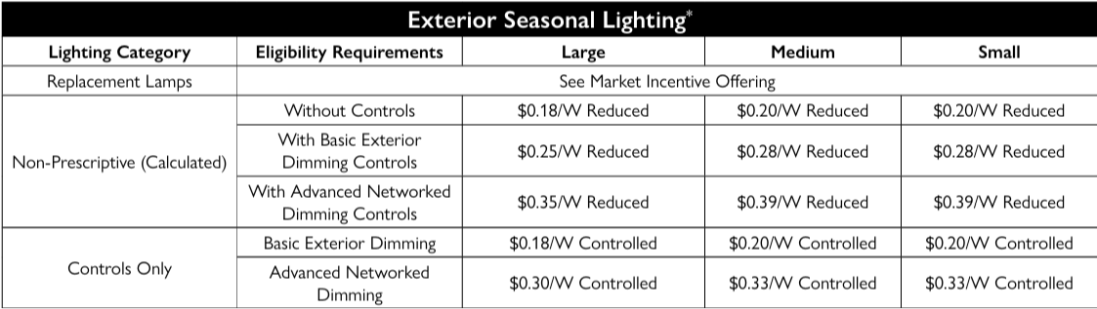
Lighting Retrofit Incentive Table Exterior

Slide 19
Wattsmart Business
HVAC & Mechanical

Slide 20
HVAC and Mechanical Incentives
Unitary Commercial A/Cs
Heat Pumps
VRF
Variable Refrigerant Flow
ARC
Advanced Rooftop Unit Controls
Bonus
Thermostats
TOP 3 INCENTIVES (TO START WITH)
BONUS

Slide 21
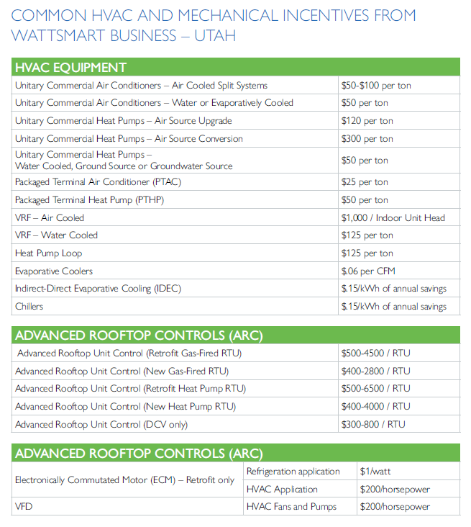
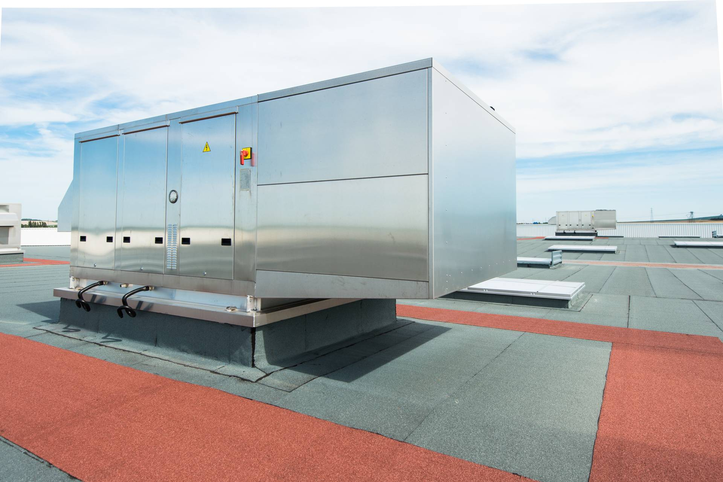
HVAC and Mechanical Incentives

Slide 22
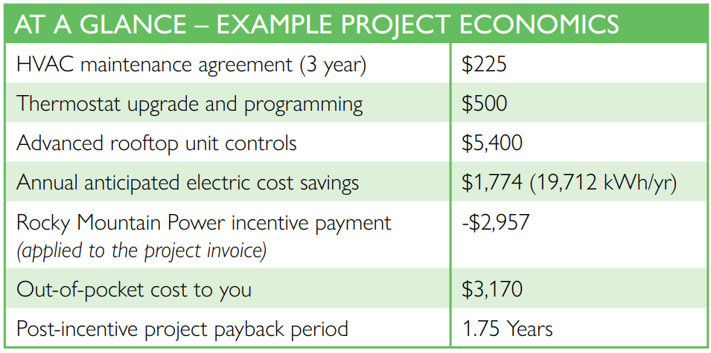
HVAC Check-Up
CUSTOMER BENEFITS:
Improve workplace comfort and indoor air quality
Reduce maintenance, repair and energy costs
Receive an energy report and a no- obligation quote for recommended upgrades and incentives
Heating and cooling can be 40-50% of business energy use (so maintenance matters)
The HVAC Check-Up in the Wattsmart Business program (Utah) is a contractor-led assessment of a building’s HVAC system that identifies energy-saving opportunities and eligible upgrades.

Slide 23
Why join HVAC Checkup?
More leads – utility-backed program drives customers to you
Higher close rates – incentives reduce sticker shock
Bigger jobs – check-ups uncover upgrades, not just maintenance
Credibility boost – you’re part of an approved network
Repeat business – ongoing tune-ups + future retrofits

Slide 24
What to Look Forward to in 2026
Trade Ally SPIFF opportunities
Continued program simplification
Expanded engagement and incentives

Slide 25
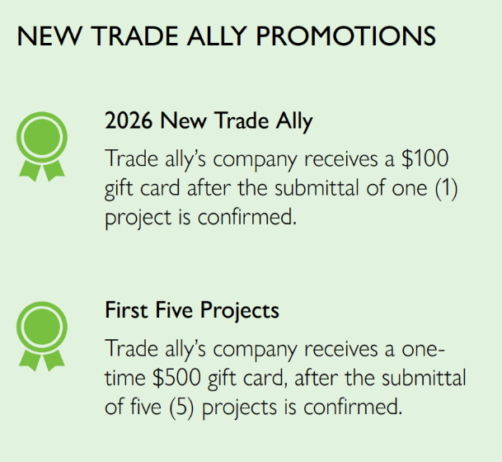
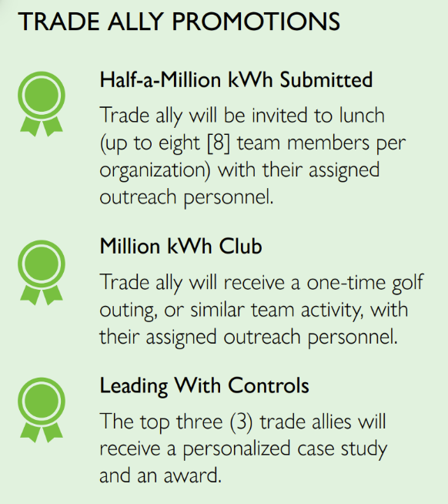
Trade ally SPIFF opportunities

Slide 26
Thank you!
WATTSMART BUSINESS

